Slide 1
Building Safety Month 2025
Week 1 – The Warm-Up

Slide 2
Welcome to Building Safety Month – Game On!
This month, we’re treating building safety like a high-stakes game. Just like any great athlete prepares before a match, safety professionals need to prepare for success.

Slide 3
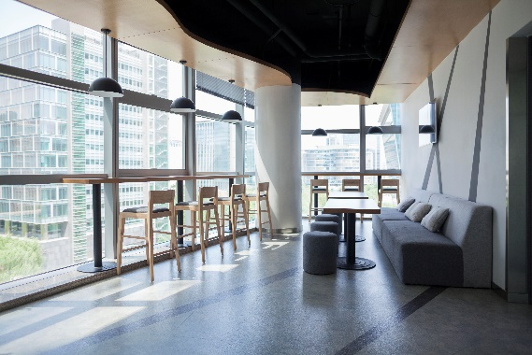
Building Safety is a Team Effort!
Building Codes are society’s best way of protecting homes, offices, schools, manufacturing facilities, stores and entertainment venues.
All communities need building codes to protect their citizens from hazards like fires, weather-related events and structural collapse.
On a community level, building safety can include adopting modern building codes or enacting sustainability initiatives.

Slide 4
Building Safety: The Rules of the Game
Building Safety is Like a Game with Rules to Ensure Success
Safety Requires Strategy, understanding risks, preparing for hazards, and planning safety procedures in advance
1. Game Plan
2. Understanding risks, preparing for hazards, knowing safety procedures in advance
Preparation is Key to Playing it Safe
1. Train, Prepare, Use Right Equipment
2. Safety Gear (hard hat, safety vests, etc.), Building Codes
Teamwork Wins the Game
1. Builder, Architect, and Contractor assumes their respective roles
2. Safety Coordination Among All Team Members
Avoiding “Penalties” and “Losing the Game”
1. Do Not Ignore Safety Protocols

Slide 5
DISCIPLINES OF BUILDING SAFETY
The Building Safety Profession covers every aspect of the life of a building, from planning and construction to use, operation and maintenance. Building Safety Professionals assist design professionals, contractors, building owners and the public to understand how to design, construct, operate and occupy buildings in conformance with the International Codes and technical standards adopted by local and state jurisdictions.

Slide 6
Building
Addresses general materials and methods of construction, including heights and areas, occupancy classification, construction type, occupancy and use requirements, structural stability, interior and exterior finishes, means of egress, accessibility and safeguards during construction. (Click to learn about the IBC, IRC, IZC )

Slide 7
Fire
Addresses the hazards of smoke and fire arising from building operations, occupancy, storage and use, fire detection, suppression and alarm systems and conditions affecting safety of fire fighters and emergency responders during emergency operations. (Click to learn about the IFC, IWUIC)

Slide 8
Plumbing Electrical
Addresses the design, construction and installation of electrical components, appliances, equipment and systems in buildings.
Addresses the design construction, installation, operation and maintenance of plumbing, mechanical and fuel gas systems in buildings, also includes swimming pools and spas.

Slide 9
Energy and Sustainability
Addresses the design, construction and installation of energy conservation features in buildings, use of natural resources in building construction, and indoor environmental quality and comfort.

Slide 10
The Life of a Building
A building begins as an idea. From the moment a building is imagined, components of building safety shape its development, design, construction, operation and use, contributing to the quality of life and economic vitality of a community

Slide 11
Renovations
If the owner wishes to alter an existing building’s construction or change its use, the process is subject to the application and issuance of a building permit, construction inspection(s) and issuance of Certificate of Occupancy or Compliance by the Code Official.

Slide 12
Operation & Maintenance
The Fire Marshal periodically performs fire safety and property maintenance inspections to ensure the building is occupied, operated and maintained in conformance with applicable requirements of the code.

Slide 13
Construction
The contractor constructs the building in accordance with approved plans and specifications. The Building Inspector conducts periodic inspections to ensure the work conforms with approved plans and specifications. Upon completion, a Certificate of Occupancy (or Certificate of Compliance) is issued by the Code Official

Slide 14
The design professional submits building plans, specifications and a building permit application to the Permit Technician. The Plans Examiner reviews the plans and specifications for conformance with local regulations and adopted codes and standards. Once the project is determined to comply, a building permit is issued by the Code Official.

Slide 15
Planning & Development
The owner engages a design professional to plan and design a building. The Code Official assists the owner and design professional to understand proper application of zoning, codes and standards to the project. The Permit Technician provides assistance during the application and approval process.

