Slide 1
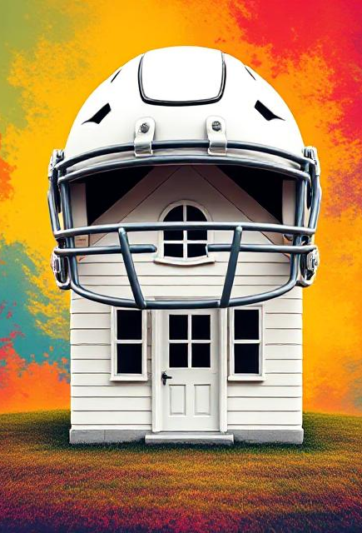
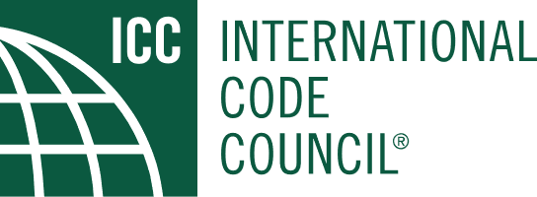
Game On: Build Your Defense
Building Safety Month 2025 – Week 3, May 11-17

Slide 2
What is Building Safety Month?
Building Safety Month is an international campaign that takes place in May to raise awareness about building safety. This campaign reinforces the need for the adoption of modern, regularly-updated building codes, and helps individuals, families and businesses understand what it takes to create safe and sustainable structures.

Slide 3
The Best Defense is a Good Offense
Building safety starts before disaster strikes. Whether it’s a fire, flood, or strong storm – the key to protecting your home, your family, and your community is to plan and take proactive steps.
Build Your Defense: means thinking like a team:
Identify potential risks in your home and neighborhood
Strengthen your home’s defenses with smart upgrades
Stay informed about local hazards and safety codes
Practice safety routines with your household
Just like in sports, success comes from preparation, teamwork, and knowing the game plan. When it comes to building safety – You’re on the front lines.

Slide 4
Scout the Field Know what you’re up against – like scouting the opponent.
Scout your area for:
Weak spots in your home
Local weather patterns
Emergency response times
Community resources

Slide 5
Code is the Playbook!
Why do codes matter?
The set the minimum safety standard for how buildings are designed and built.
Help prevent injuries, deaths, and costly damage in disasters.
How do inspections help?
Ensure that builders follow the code at every stage.
Catch mistakes early, before they become dangerous or expensive.
Importance of up-to-date standards
Reflect the latest research and technology in building safety.
Help homestay resilient to new threats and climate changes.

Slide 6
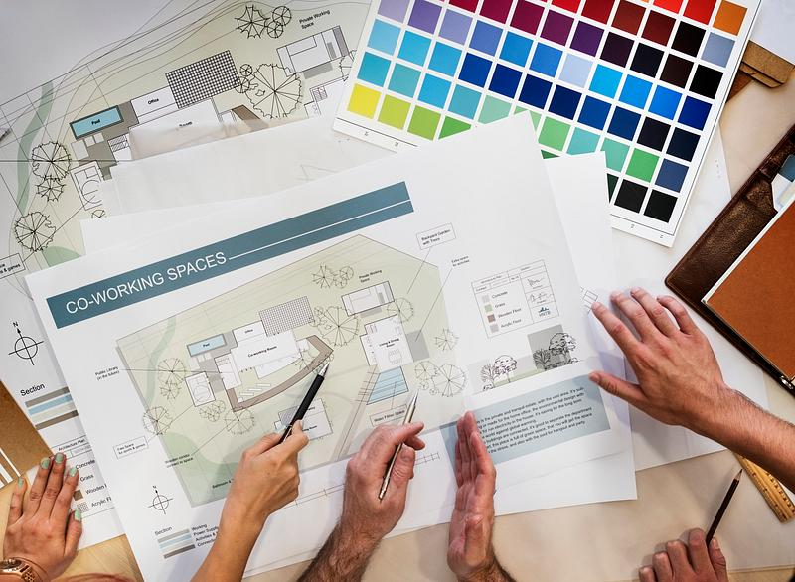
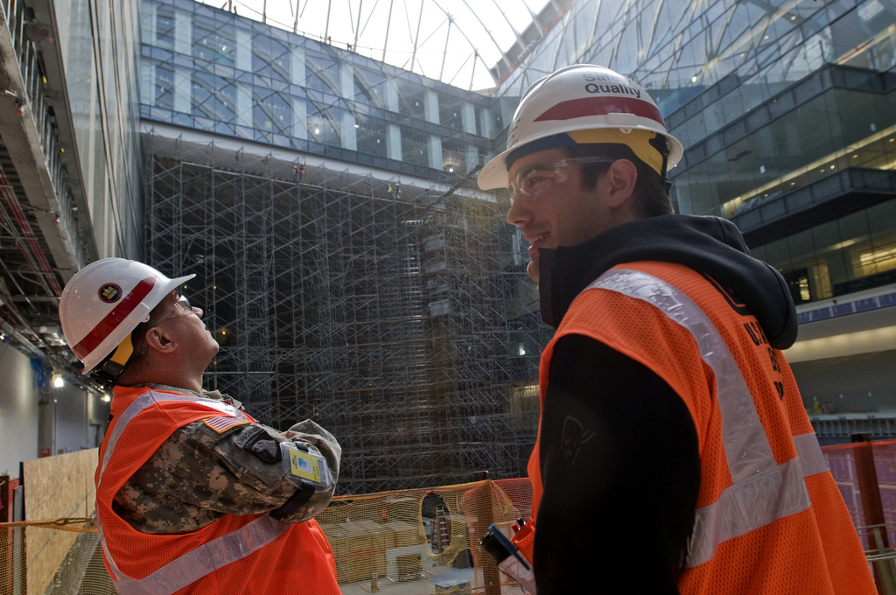
Team Up With the Pros Just Like in Sports, You Need a Solid Team
Who’s on your building safety team?
Architects
Engineers
Inspectors
Code Officials

Slide 7
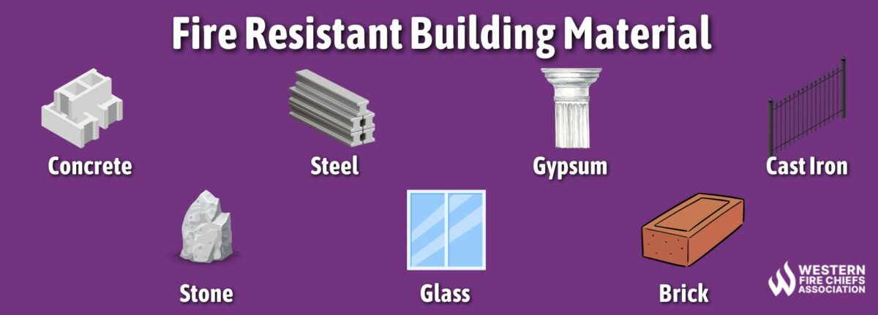
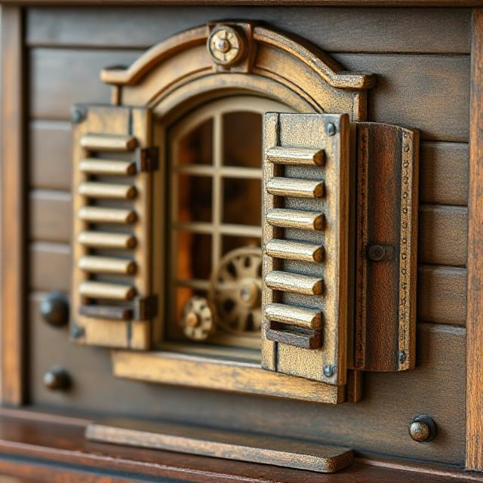
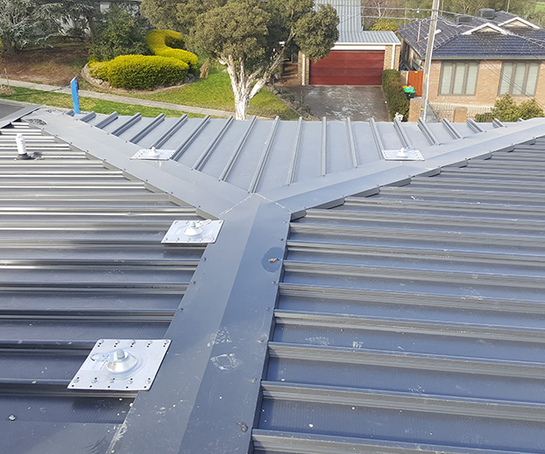
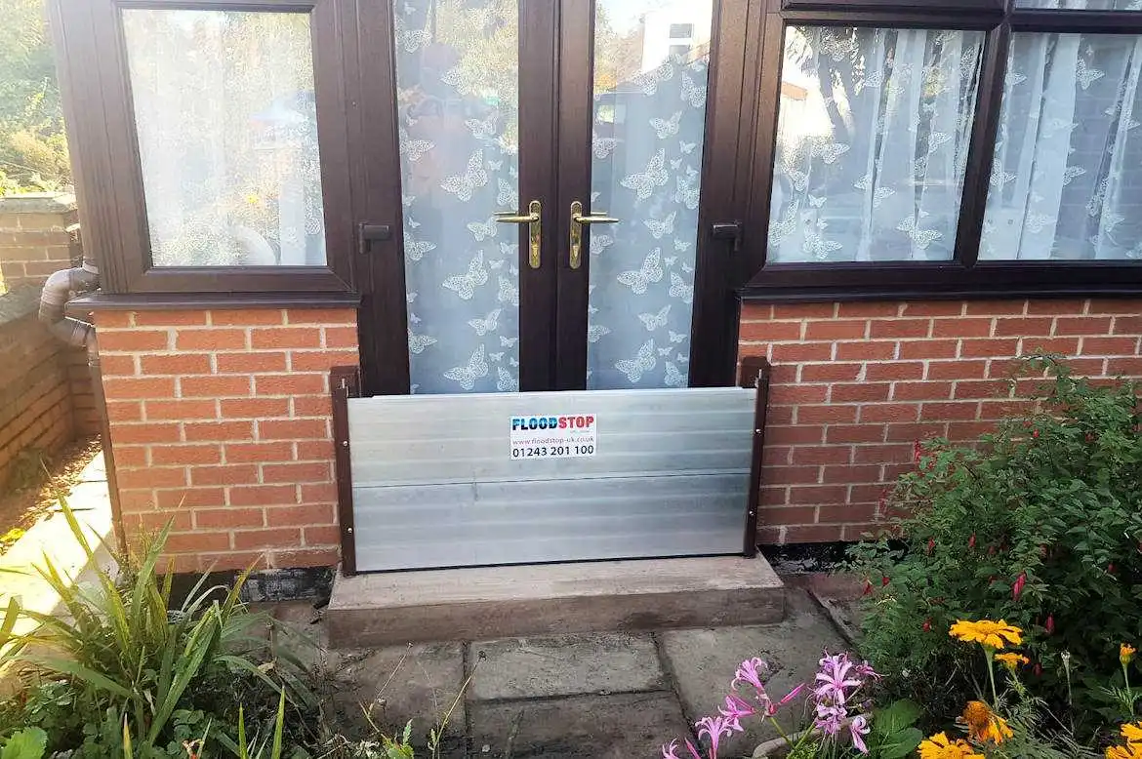
Defensive Upgrades Think like a defensive coach – strengthen weak points

Slide 8
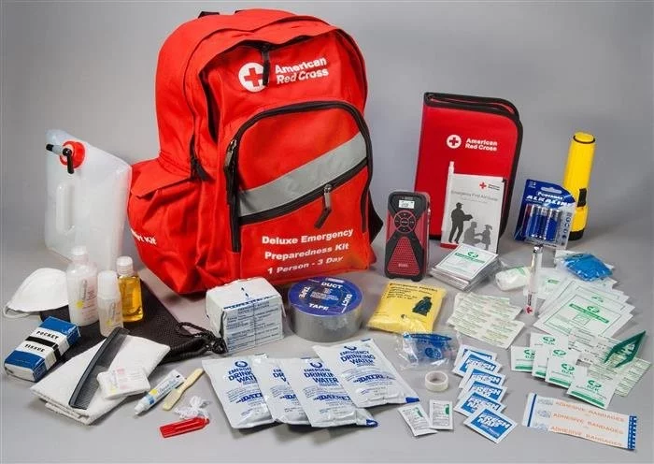
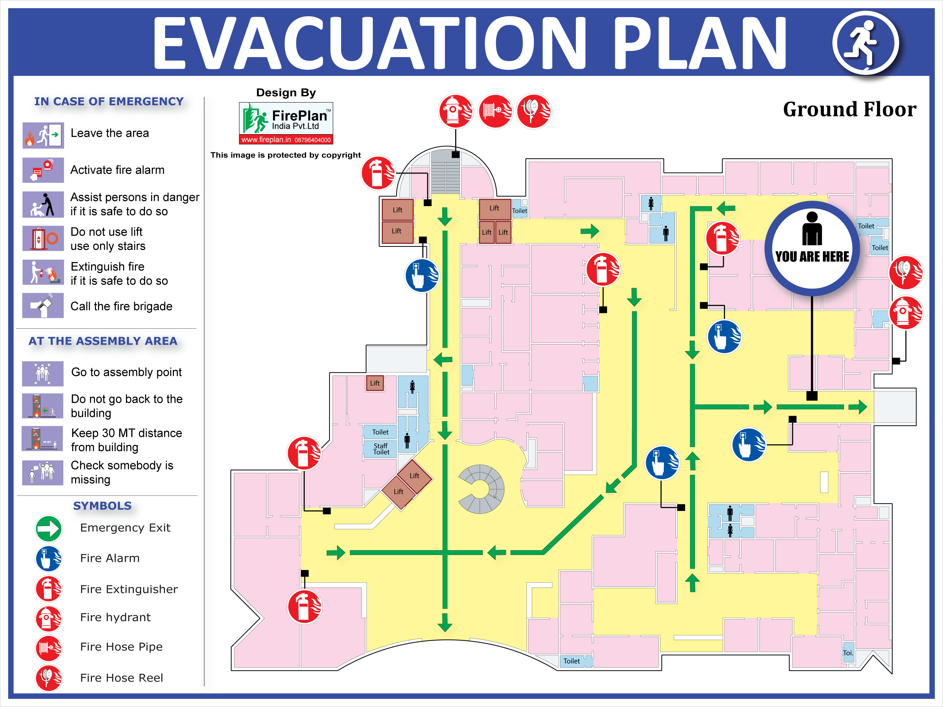
Practice Makes Prepared
The Best Defense is Knowledge

Slide 9
Stronger Together – Community Resilience Starts with Safe Buildings
El Dorado County Communities
Adopt and enforce modern building codes
Support safe rebuilding after disasters
Encourage retrofits for older buildings
Share resources on local risks and upgrades.

Slide 10
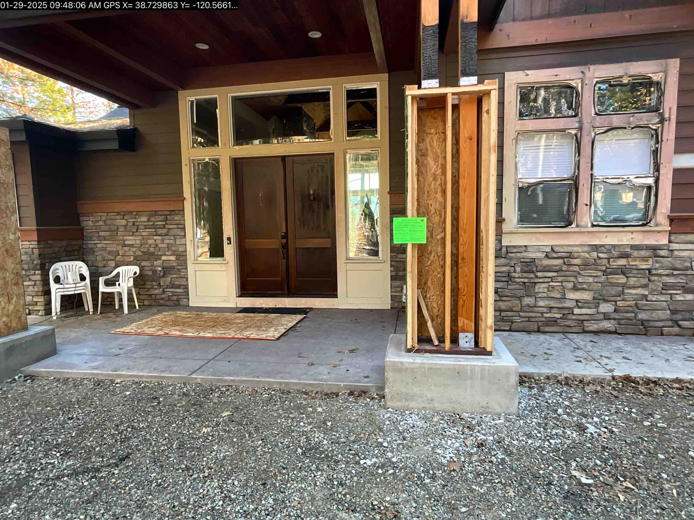
Home Hardening in the WUI (wildland-urban interface) within El Dorado County
Home hardening is a term used to describe purposeful actions taken to help protect buildings in WUI zones. Home hardening provisions within WUI codes rely on a combination of prescriptive requirements and performance requirements based on standardized tests.

Slide 11
Get in the Game
Ready to Build Your Defense?
Visit ICC
https://www.iccsafe.org/
Obtain your building permit
EDC Building Division

