Slide 1
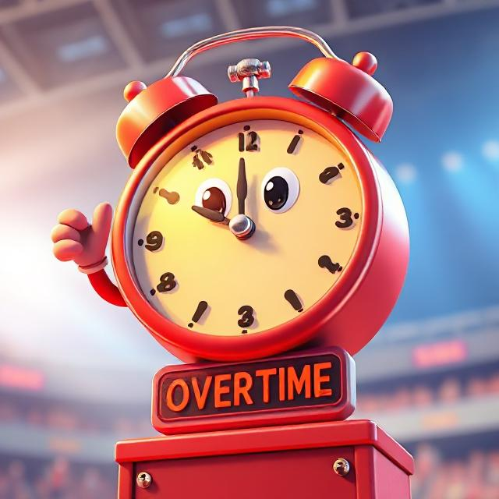


GAME ON: Week 5
Going Into Overtime
Building Safety Month * May 25-31
Staying ahead with innovation and ongoing commitment

Slide 2
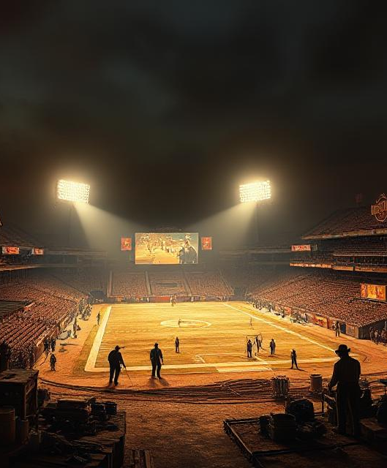
Safety Doesn’t Stop After the Final Whistle
Building safety is a game that never ends. In Week 5, we highlight the importance of staying current on evolving codes, technologies, and global trends that shape safer communities.

Slide 3

The Game Changes – So Should We
New risks – new responses
Modern buildings = modern codes
Staying informed is how we win
Building professionals are always learning

Slide 4

GenAI: Powering the Next Play in Building Safety
AI is transforming both sports analytics and building safety
GenAI tools help professionals search building codes, regulations, and case studies in seconds
Enables faster, smarter decision-making in the field
Spots risk patterns and predicts vulnerabilities before they become hazards
Quickly diagnoses issues like structural stress, environmental hazards, or malfunctions
Helps take proactive, corrective actions to keep buildings safe

Slide 5
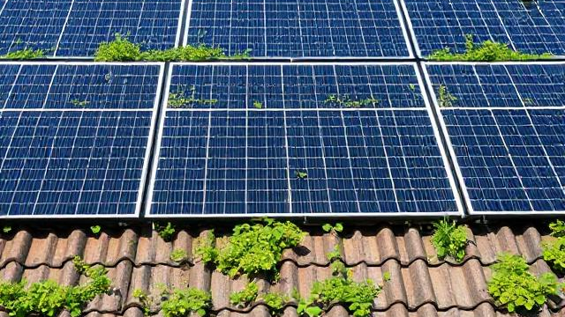
Sustainability =
Long-Term Victory
Energy-efficient materials and systems
Net-zero buildings
Resilient designs to combat climate change

Slide 6

Resilience & Disaster Readiness
Ready for Anything
  Codes now address hurricanes, wildfires, floods
  Focus on survivability and quick recovery
  Retrofitting older structures
  Community-based disaster plans Wildfire & Disaster - El Dorado County

Slide 7

Global Trends in Building Safety
Learning from the World’s Playbook
  International Code Comparisons
  Modular & prefab innovations
  Digital permitting and inspections
  Urban density & smart cities

Slide 8
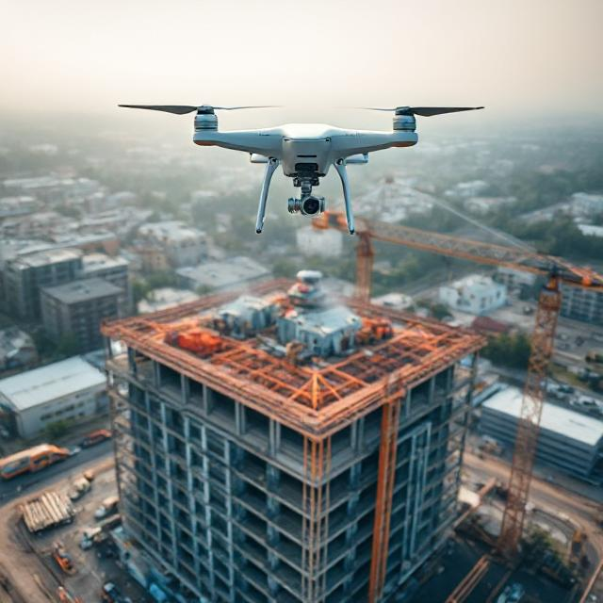
Technology in Inspections
High-Tech Tools for Safety
  Drones for roof and structural inspections
  Thermal imaging for energy efficiency
  Augmentented Reality (AR) for code visualization
  Cloud-based reporting systems

Slide 9
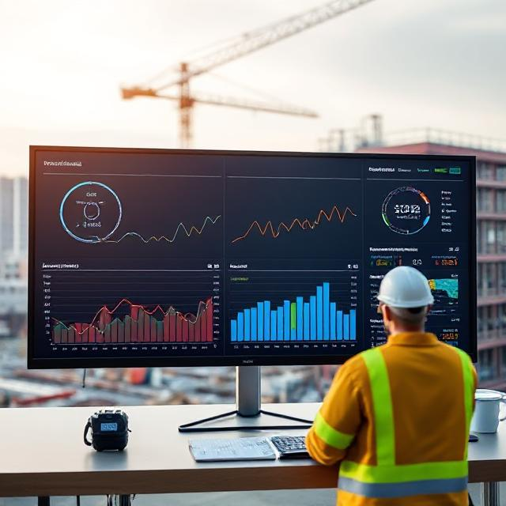
Data-Driven Safety
Building with Data, Not Just Bricks
  Predictive maintenance
  Smart sensors alerting to issues (e.g., gas leaks, cracks)
  Centralized building safety databases
  Machine learning to anticipate code violations

Slide 10

What This Means for You
Homeowners & Pros: Stay in Game
  Stay educated on trends and code updates
  Partner with qualified professionals
  Ask your local building department about tech and policy changes
  Your involvement keeps the community safe

Slide 11

Building the Future, Together
We’re All on the Same Team
  Building safety is a shared responsibility
  Professionals, homeowners, officials = one unit
  The future is smart, safe, and strong

Slide 12

Learn More & Share
Keep the Momentum Going!
  Visit www.iccsafe.org
  Explore future-forward code updates
  Follow the International Code Council
  Share what you’ve learned – keep safety trending!

