Slide 1
Building Safety Month – Week 2 May 4-10, 2025 El Dorado County Planning and Building Department

Slide 2
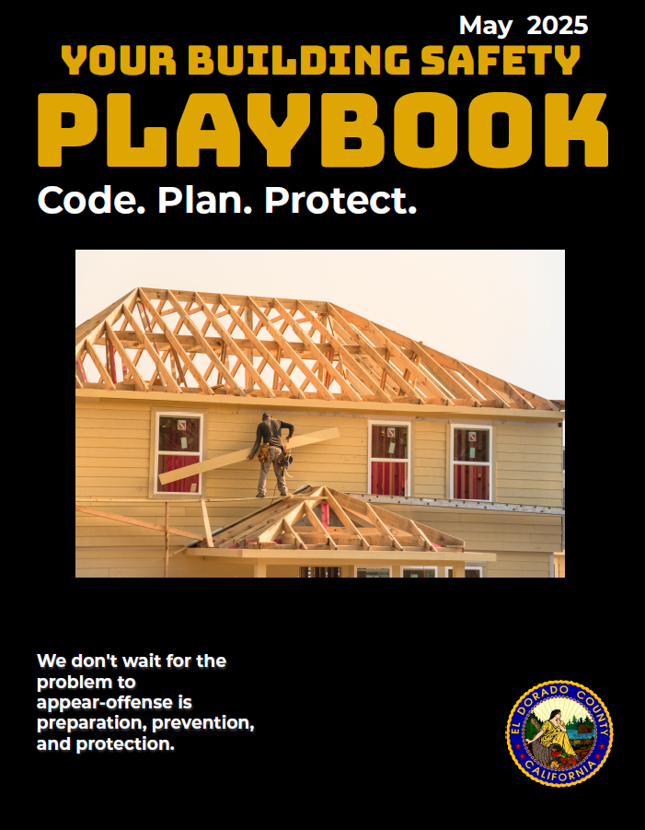
“Build Your Offense” Encouraging Proactive Engagement in Building Safety
Building Safety Month is an international campaign that takes place in May to raise awareness about building safety. This campaign reinforces the need for the adoption of modern, regularly-updated building codes, and helps individuals, families and businesses understand what it takes to create safe and sustainable structures.

Slide 3
Take Proactive Steps Before Issues Arise
Buy for the Long Haul: How to choose a Resilient House
Location & layout of home
Weather Conditions
Past & Present Condition
Which Building Code Cycle
Tour the Home

Slide 4
Know the Code Your Offense Starts with Code Compliance
Building Codes are your first line of defense
Building Codes Protect
Building Codes Work
Building Codes are Always Improving
Building Codes Help Your Community

Slide 5
Meet the Team: Inspections
Inspectors are like the quarterback-reading the field and calling the plays.
Regular inspections catch problems before they become emergencies.
Structural, electrical, fire systems-each inspection plays a role.

Slide 6
Offense in Action: Fire Safety
Fire doesn’t wait. Neither should we.
Working smoke alarms reduce death risk by 55%.
Install, inspect, and maintain.

Slide 7
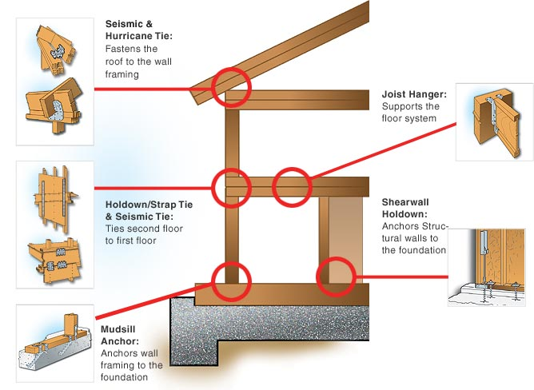
Strength Starts with Structure
When nature hits, structure saves lives
Buildings must withstand wind, floods, earthquakes
Reinforced framing, flood barriers, flexible joints = proactive defense.

Slide 8
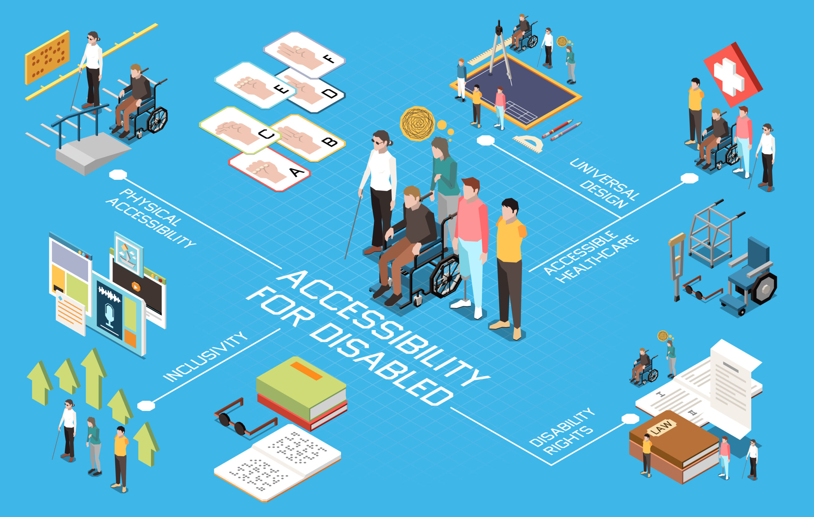
Build for Everyone: Accessibility
We win as a team when everyone can safely enter and exit.

Slide 9
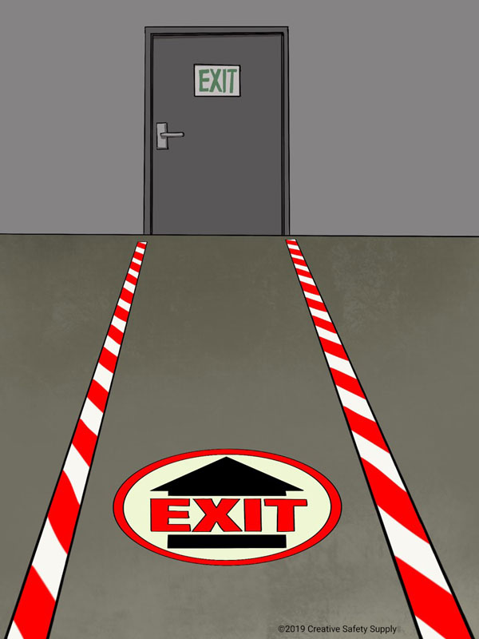
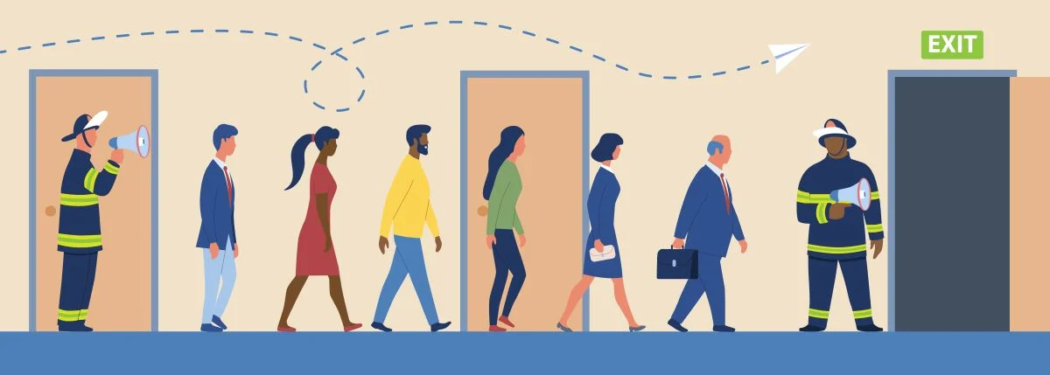
Emergency Plans: Your Playbook
You don’t make a play without a plan-same goes for safety.
Evacuation routes, fire drills, contact plans = safety readiness
Everyone should know the plan

Slide 10
Innovation = A Smarter Offense
Smart buildings aren’t just cool-they’re lifesavers.
Tech tools: AI building monitoring, smart alarms, real-time code updates.
Drones and apps help inspectors and builders work safer, faster.

Slide 11
Who’s on Your Team?
Every team member matters-from builder to occupant.
Proactive Safety requires everyone to play a role.

Slide 12
Community Collaboration = Safer Spaces Offense works best when the whole community is in the huddle

Slide 13
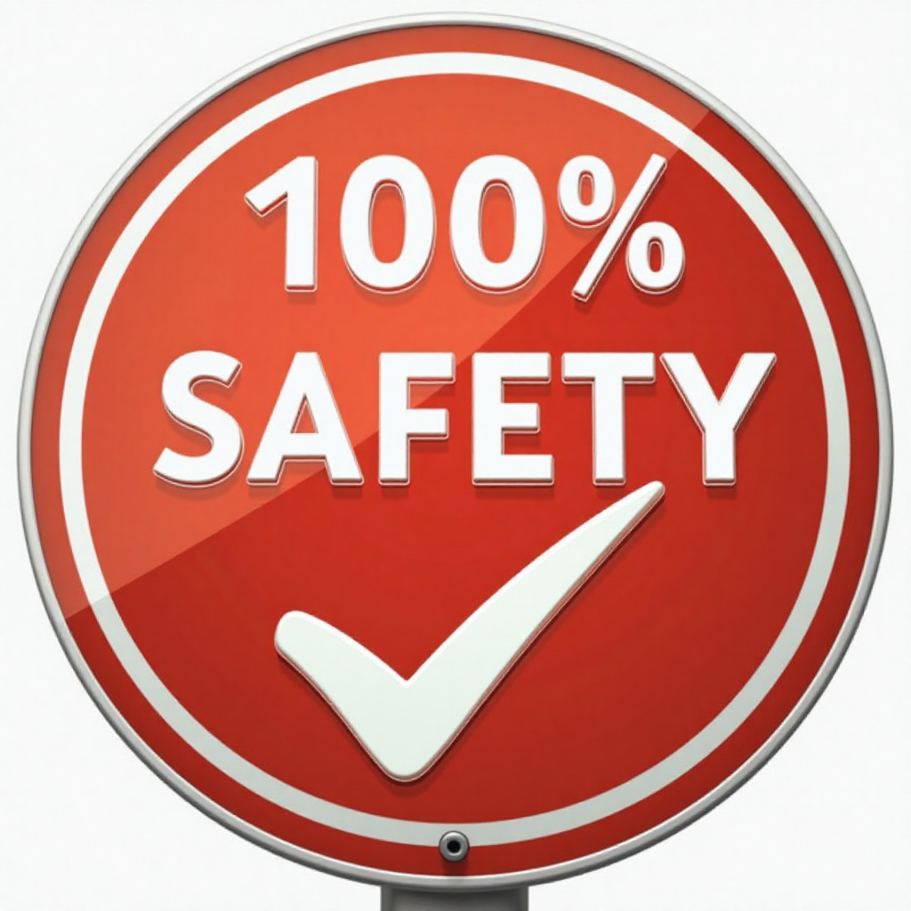
Call to Action: Get in the Game
You’ve got the playbook. Now it’s time to run the play.
Schedule an inspection
Review your emergency plan
Share safety tips
Visit El Dorado County Building Division

