Slide 1
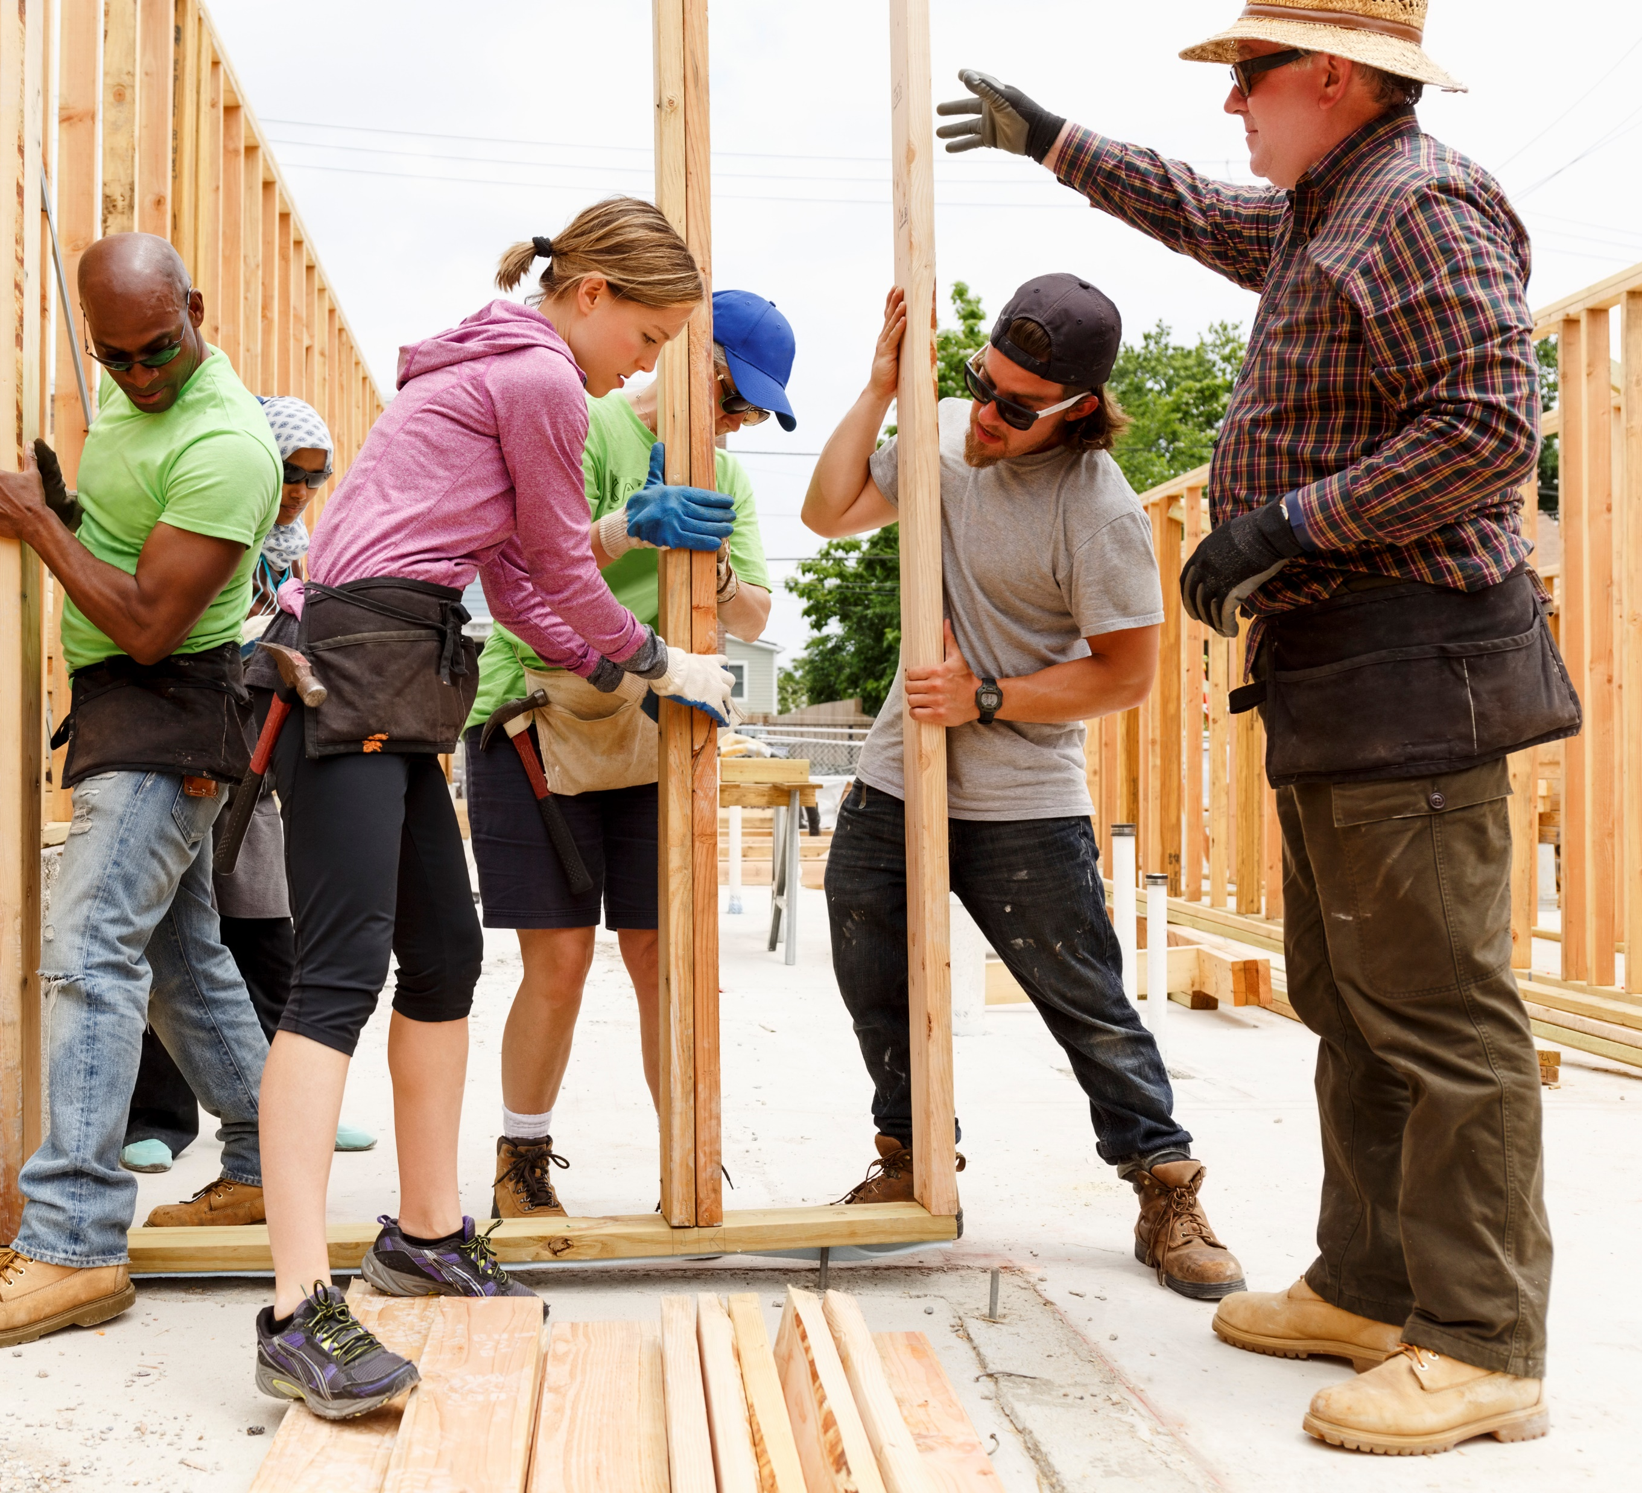

Voices of the Built Environment
Building Safety Month * May 11-17

Slide 2
What This Week Focuses On
Recognizing the professionals who keep buildings safe
Highlighting how they protect homes, workplaces, and public spaces
Celebrating their commitment, training, and expertise
Encouraging the public to learn more and get involved

Slide 3
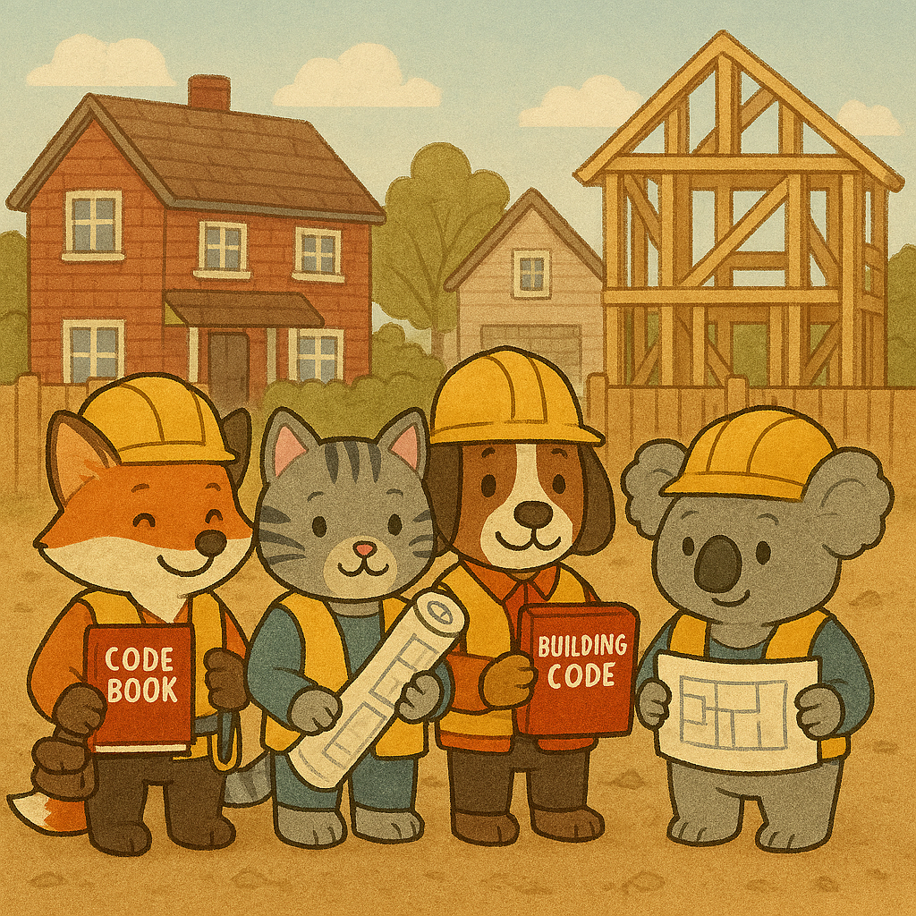
Who Are Building Safety Professionals?
Experts who guide projects from planning through construction
Ensure buildings remain safe over time through inspections
Apply building codes to protect the public
Support homeowners, contractors and local leaders with safety guidance
Work across residential, commercial, and public projects

Slide 4
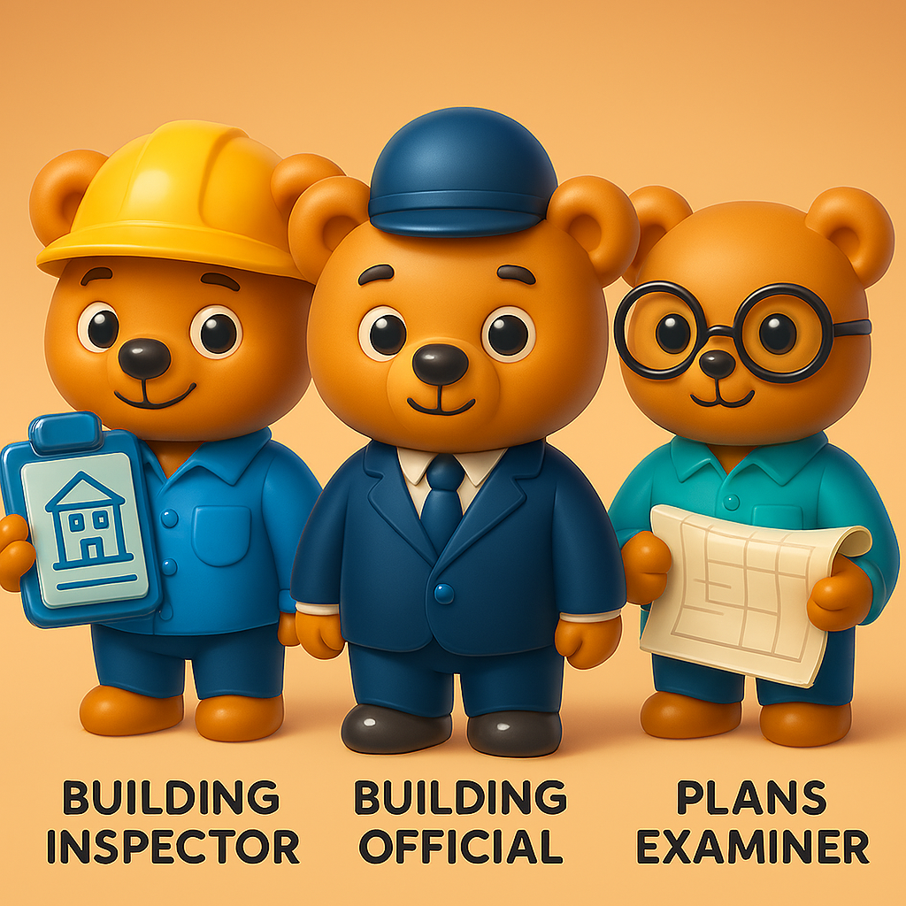

Examples of Building Safey Roles
Building Inspectors
Building Officials
Plans Examiners
Permit Technicians
Fire Marshals

Slide 5
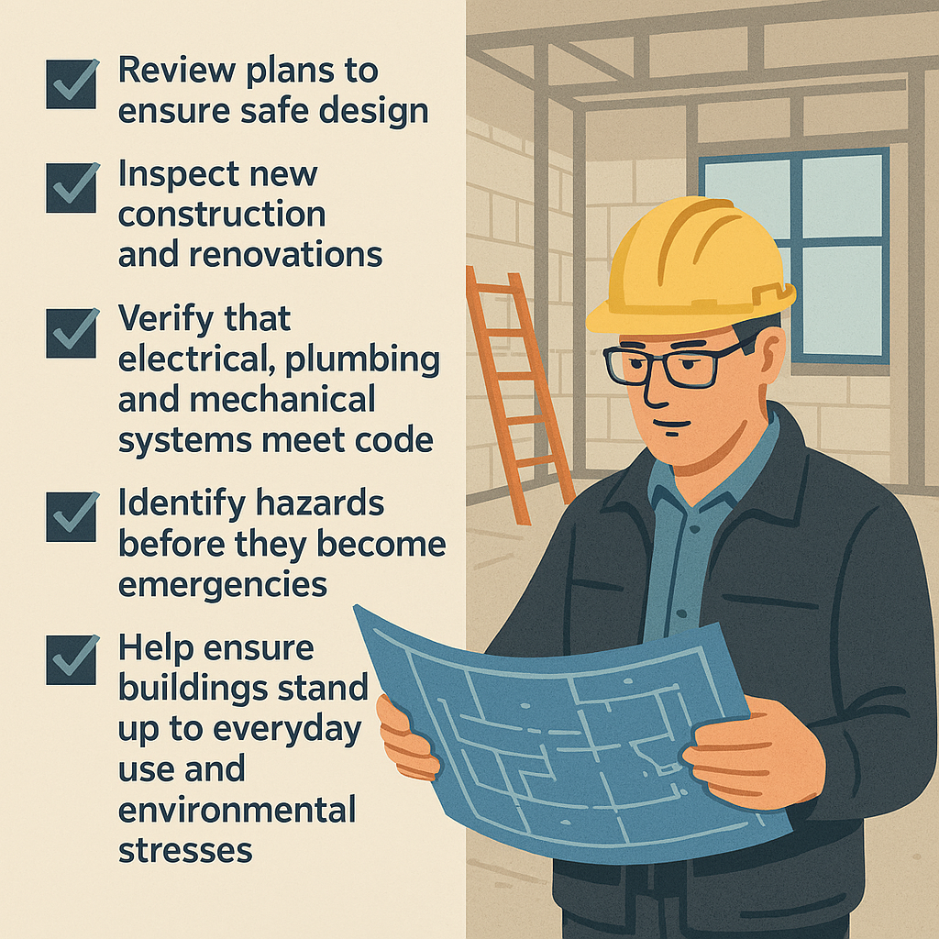
What These Professionals Do

Slide 6
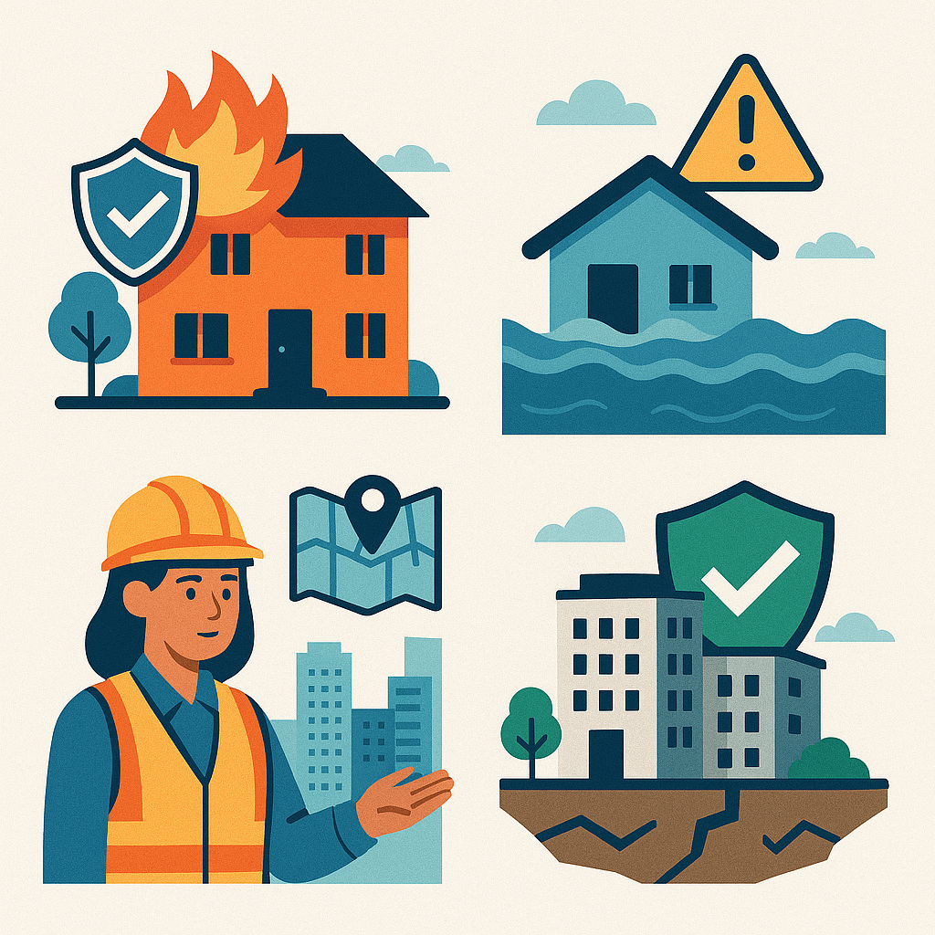
Why Their Work Matters
Reduces risks from fire, flooding, structural failure and more
Protects lives and property
Supports strong community planning and development
Improves long-term durability and safety of buildings

Slide 7
When to Contact Your Building Department
Before starting major home improvements
When adding or altering electrical or plumbing systems
When changing structural elements
When you’re unsure whether a permit is required
For questions or guidance on safety requirements

Slide 8

What Building Code Officials Do for You
Review building plans and permit applications
Conduct on-site inspections
Provide code interpretations
Help ensure projects are safe to occupy

Slide 9
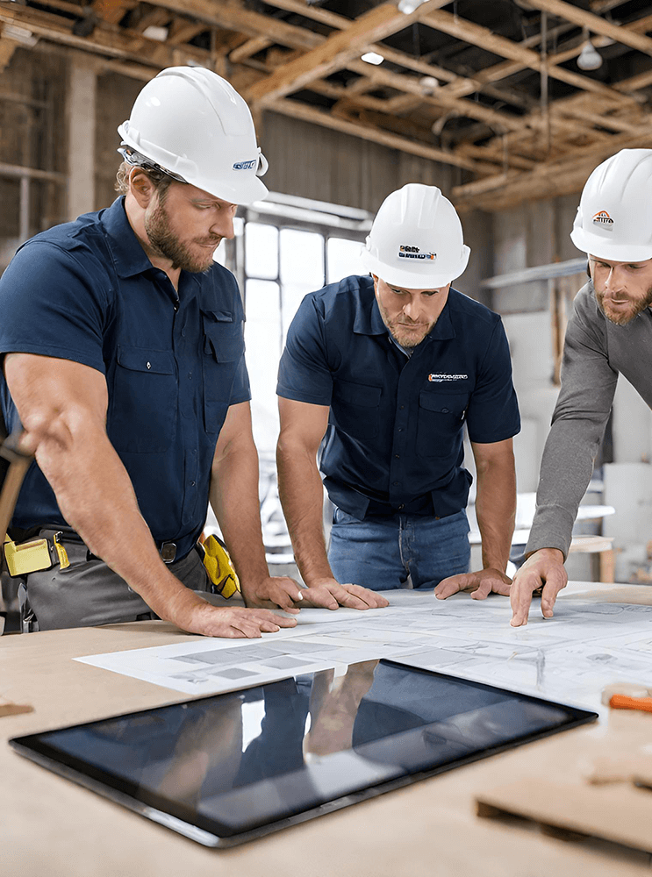
Careers in Building Safety
Meaningful, community-focused career paths
Opportunities to specialize in fire, electrical, mechanical, structural and more
Combine office work with field inspections
Work in public agencies, private industry or consulting
In-demand roles across many regions

Slide 10
What Makes This Field Unique
Blend of technical expertise and public service
Opportunities for career growth
Work touches countless aspects of daily life
Critical to long-term community resilience

Slide 11
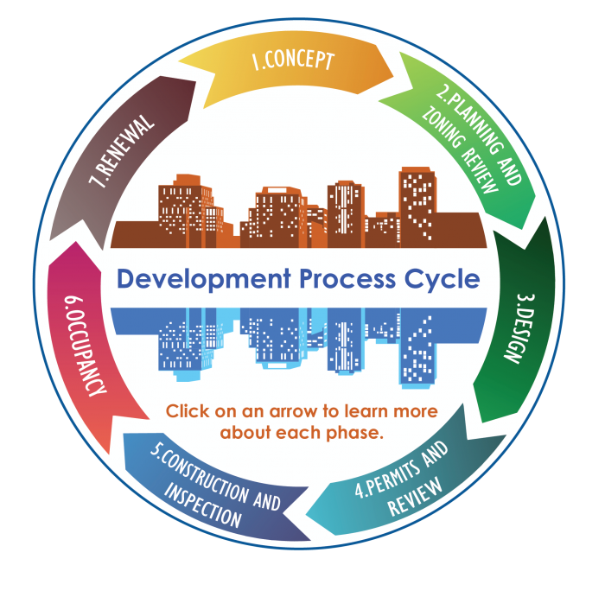
Raising Awareness & Getting Involved
Share accurate building safety information online
Encourage local media to highlight safety stories
Speak with community leaders about safety concerns
Attend or host building safety events
Connect with your local building department for ways to learn more

Slide 12
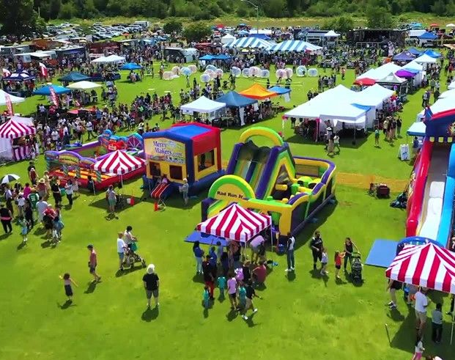
Building Safety Starts with People
Building safety professionals protect the places we rely on
Their Training and dedication keep our communities safer
Everyone can support safer buildings by staying informed and engaged

