Slide 1

El Dorado Hills Proposed Costco Draft EIR
Owner: Costco Wholesale Corporation
Applicant: Urban Planning Partners, Inc.
Project Numbers: PD15-0001; CUP23-0012; V22-0001
February 25, 2026

Slide 2
Staff in Attendance
County
  Ande Flower, Planning Manager
  Cameron Welch, Senior Planner
  Zach Oates, Department of Transportation
Ascent – County’s EIR Consultant
  Pat Angell, Principal-in-Charge
  Marianne Lowenthal, Project Manager
  Dimitri Antonio, Noise Analysis, Ascent
  Ramboll -- Air Quality and GHG
    Eric Lu, Regional Director
    Siena Moca, Senior Consultant

Slide 3
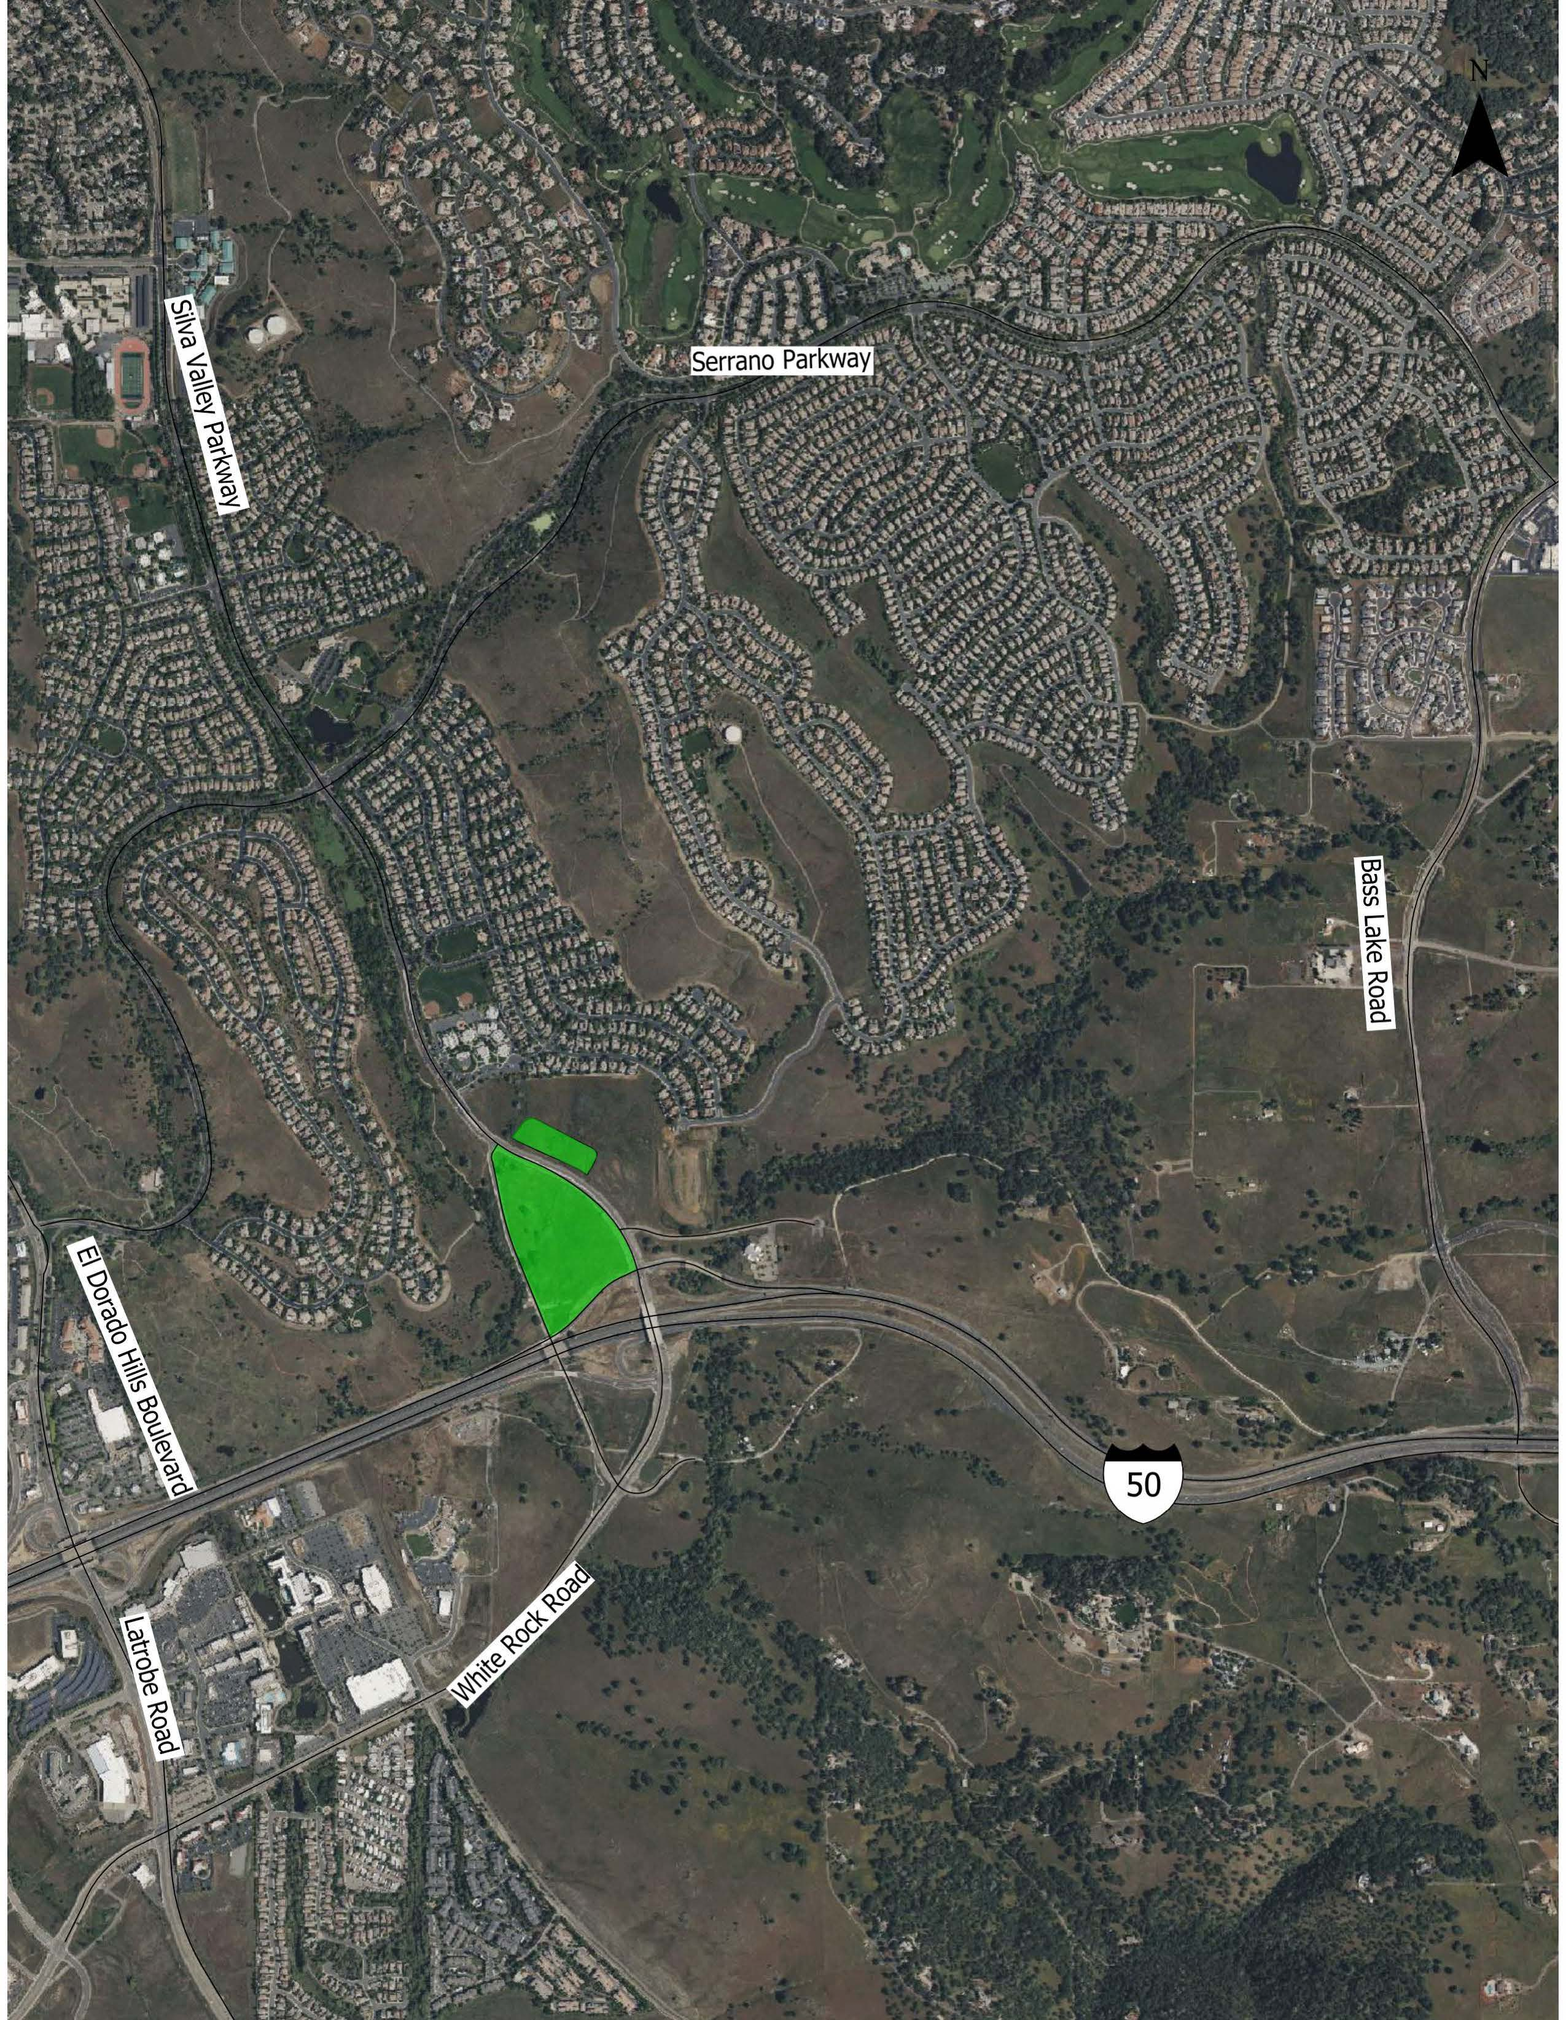
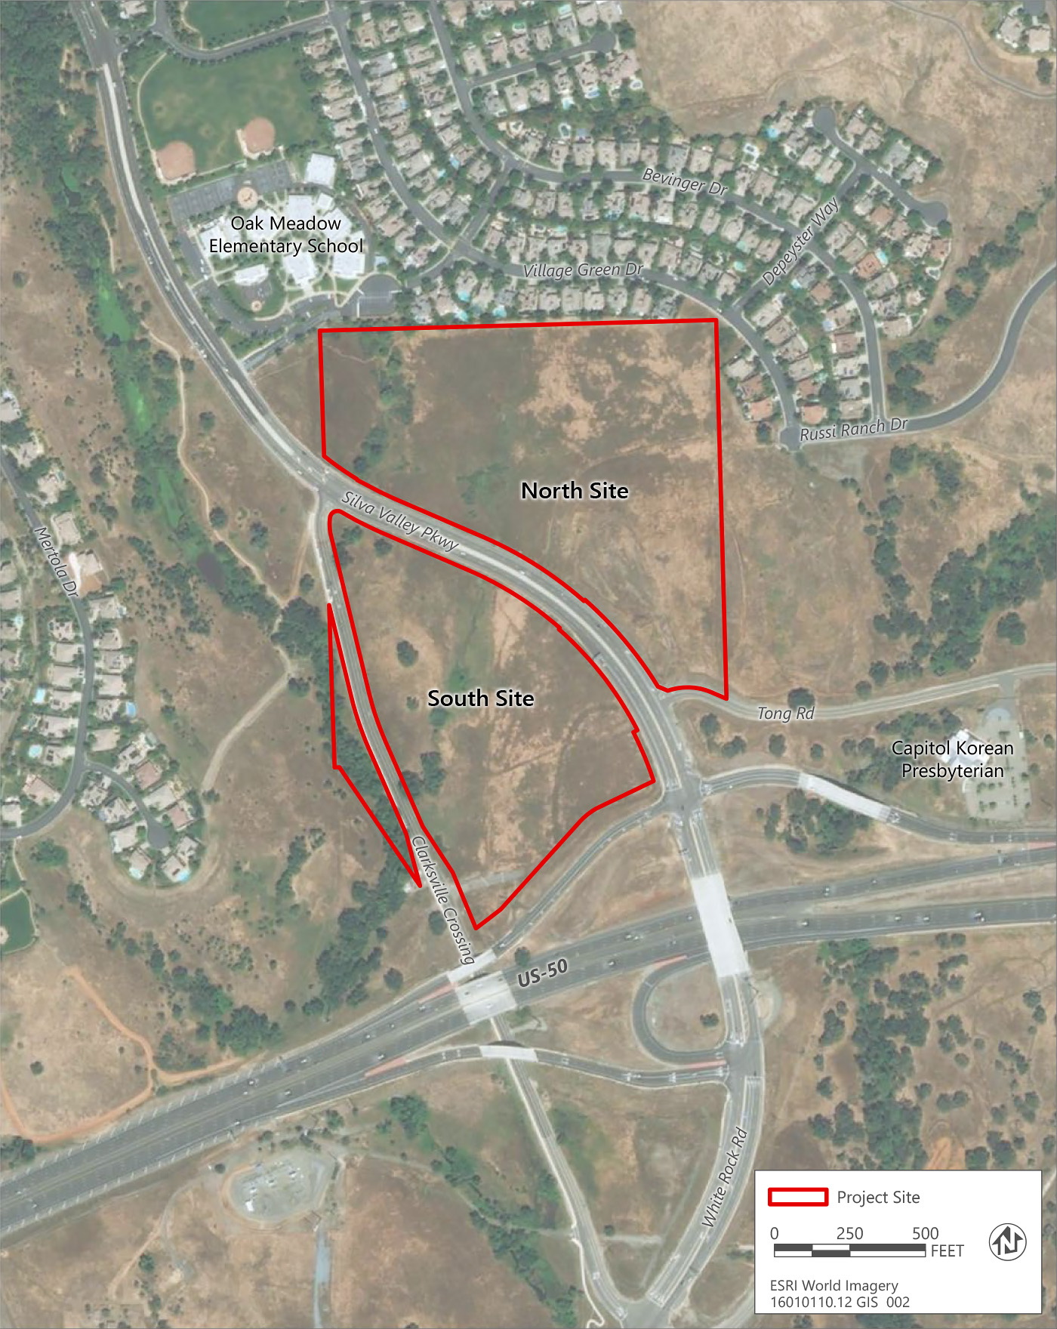
Project Site
Silva Valley Parkway, north of US 50
43.26 acres
  North Site: 24.83 acres
  South Site: 18.42 acres
General Plan – Commercial
Zoning – Commercial Regional - small portion Commercial Limited, which is proposed for parking and access.

Slide 4
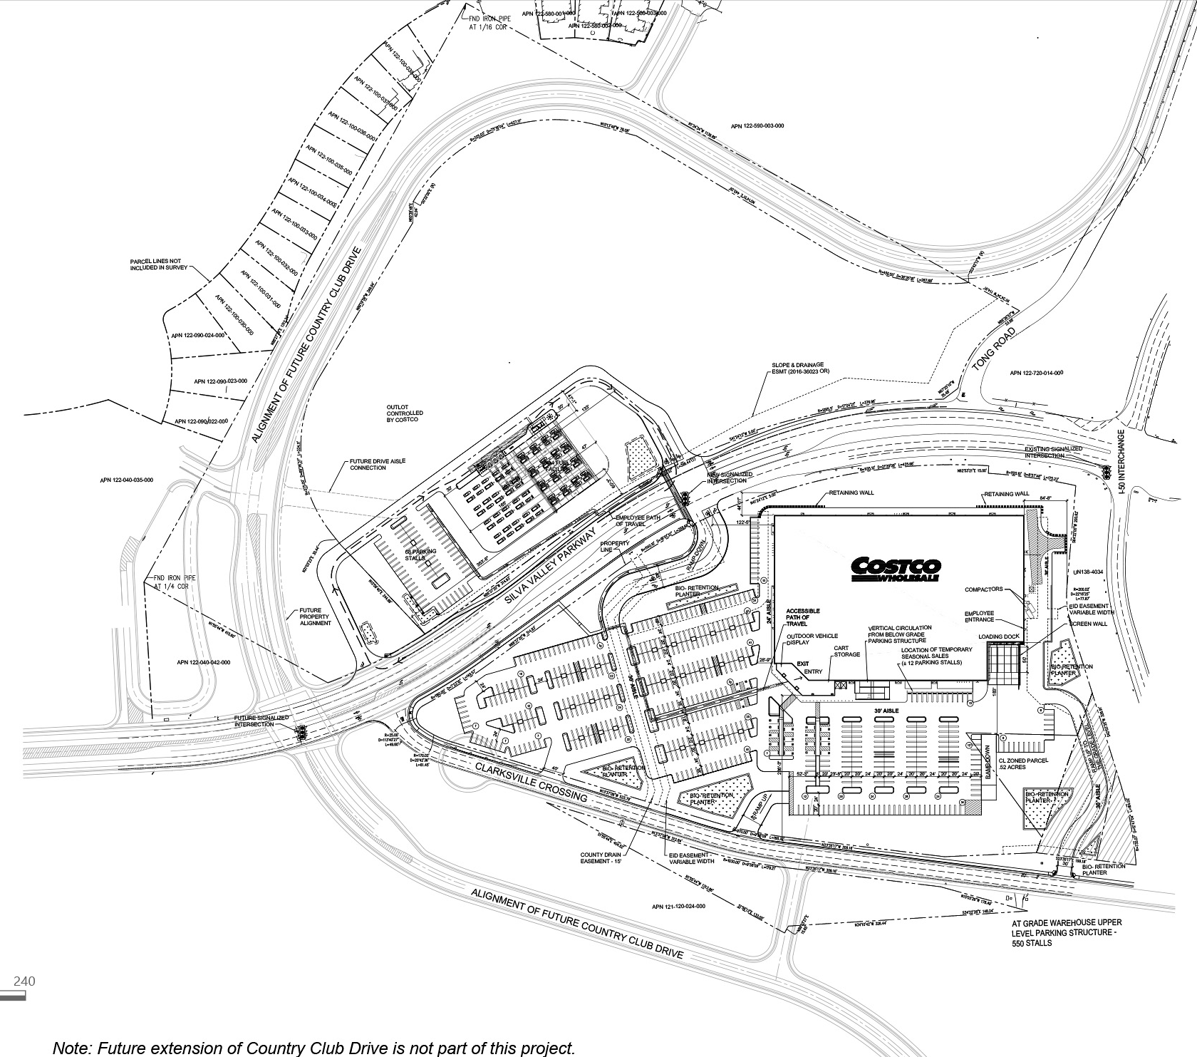
Proposed Development
  South - Costco Retail Warehouse – 165,000 sf
  Parking structure and surface parking
    ~760 spaces - South Site,
    ~70 employee spaces - North Site
  North Site Remainder Area – 13.79 AC
    No development proposed by Costco
    Project includes annexation into Water and Fire districts
Possible Alignment of Future Country Clug Drive
Remainder Area
Oak Meadow Elementary
BUMI Charter School

Slide 5
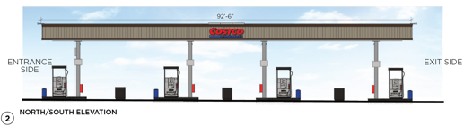
Proposed Development
Northeast Perspective
Entry Canopy
Southwest Perspective

Slide 6
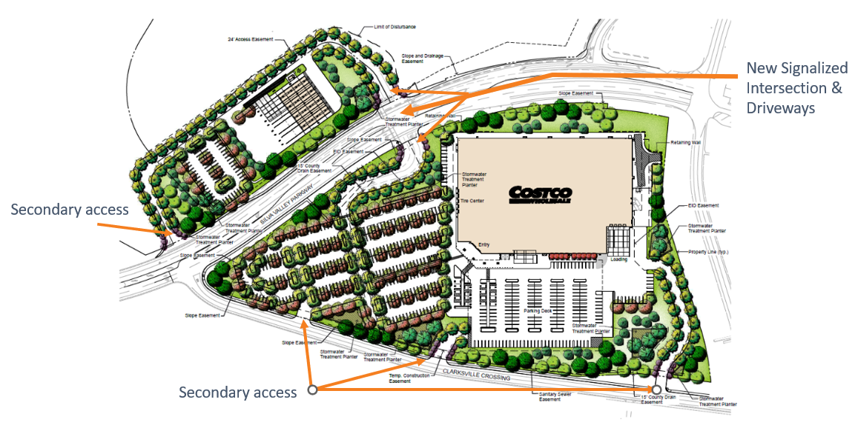
Project Access Improvements
New Signalized Intersection & Driveways with150-foot dual northbound left-turn lanes
Also White Rock Road and Valley View Parkway-Vine Street intersection left-turn storage
Note: The future extension of Country Club Drive is a separate County project

Slide 7
Key Approvals/Actions
EIR Certification
County
  Planned Development Permit
  Conditional Use Permit: tire center, outdoor display and sales (e.g., Christmas trees), possible nighttime construction (e.g., concrete pours)
  Variance for building signage area
  Tree permit
  Lot line adjustment
Other Agencies
  LAFCO - Annexation to Fire and Sewer/Water Districts
  Various Resource Agency Permits related to Air Quality, Wetlands, Streambed, Water Quality, etc.
  Various Service Agency Permits related to providing Water and Sewer and Fire Protection.

Slide 8
CEQA
California Environmental Quality Act
Ensure that public agencies identify, disclose, and avoid or mitigate (where feasible) significant environmental impacts of projects, thereby protecting environmental resources
Public participation is essential
Public disclosure process
Applies to discretionary decisions by public agencies
Requires consideration of physical environmental effects and measures to avoid or mitigate environmental impacts
Certification of EIR does not indicate project approval

Slide 9
CEQA Process
Notice of Preparation (NOP)
  Comment period open for 60 days from February 28, 2025 - March 31, 2025
Scoping Meeting (March 10, 2025)
Draft EIR
  Public review period: January 21, 2026 to March 23, 2026
  Oak Meadow Elementary School community meeting: February 2, 2025
  Community meeting: February 25, 2026
Final EIR
  Will respond to all written comments related to the adequacy of the Draft EIR
Adequacy of EIR considered/EIR Certification
Project Decision

Slide 10
What an EIR Does and Does Not Do
An EIR Does…
Disclose potential effects of project on environment
Identify mitigation measures
Describe feasible alternatives to proposed project
An EIR Doesn’t…
Require mitigation for existing environmental conditions
Advocate for project under evaluation
Require project denial due to significant environmental impacts
Address economic and social issues (e.g., property values)

Slide 11
Contents of the Draft EIR
Executive Summary
Introduction
Project Description
Environmental Impacts and Mitigation Measures
Cumulative Impacts
Alternatives
Growth-Inducing Impacts
Significant and Unavoidable Impacts
Significant and Irreversible Environmental Changes
Urban Decay
Report Preparers
References

Slide 12
CEQA Baseline
EIRs evaluate the net difference between environmental conditions with and without the project.
Baseline condition = without project condition
Net changes in environmental conditions between Baseline and Baseline + Project scenarios is how CEQA assesses the project’s environmental impact

Slide 13
Thresholds of Significance
A threshold of significance defines the level of effect above the Baseline which the Lead Agency will consider impacts to be significant.
  Project Impact < Threshold of = Less than Significant
  Significance
  Project Impact > Threshold of = Significant
  Significance (Mitigation Required)

Slide 14
Issue Evaluated in the Draft EIR
Aesthetics
Air Quality (LTS w/MM)
Biological Resources (LTS w/MM)
Cultural Resources (LTS w/MM)
Energy
Geology, Soils, & Paleo Resources (LTS w/MM)
Greenhouse Gas Emissions and Climate Change
Hazards & Hazardous Materials (LTS w/MM)
Hydrology and Water Quality
Land Use and Planning
Noise and Vibration (LTS w/MM)
Population and Housing
Public Services and Recreation
Transportation VMT (SU)
Tribal Cultural Resources (LTS w/MM)
Population and Housing
Utilities and Service Systems
Wildfire and Evacuation (LTS w/MM)
Cumulative Impacts
Growth Inducement
Urban Decay

Slide 15
EIR Project Alternatives
State CEQA Guidelines Section 15126.6 requires EIRs to describe:
  A range of reasonable alternatives to the project, or to the location of the project, which would feasibly attain most of the basic objectives of the project but would avoid or substantially lessen any of the significant effects of the project, and evaluate the comparative merits of the alternatives. An EIR need not consider every conceivable alternative to a project. Rather it must consider a reasonable range of potentially feasible alternatives that will foster informed decision making and public participation.

Slide 16
EIR Project Alternatives
  No Project-No Development Alternative
  No Project-Development Consistent with General Plan and Zoning
  Flipped Costco Project Site Plan Alternative (relocation of Costco warehouse retail building to the North Site and relocation of fuel facility to South Site)
  Fuel Facility Relocation Alternative (fuel facility would be sited further southeast on the North Site)
  Offsite Alternative (relocation of Costco warehouse retail building and fuel facility to the northern portion of the El Dorado Hills Business Park)
  Costco Project on North Site Alternative (placement of Costco warehouse retail building and fuel facility to the North Site)

Slide 17
Summary Comparison of Alternatives
Environmental Topic | Proposed Project Impact Summary | Alternative 1 No Project – No Development Alternative | Alternative 2 No Project – Development Consistent With General Plan and Zoning Alternative | Alternative 3 Flipped Costco Project Site Plan Alternative | Alternative 4 Relocation of Fuel Facility Alternative | Alternative 5 Offsite Alternative | Alternative 6 Costco Project on North Site Alternative
Aesthetics | Less than significant | Less | Similar | Greater | Similar | Similar | Greater
Air Quality | Less than significant (with mitigation) | Less | Less | Greater | Greater | Less | Greater
Biological Resources | Less than significant (with mitigation) | Less | Similar | Similar | Similar | Similar | Similar
Cultural Resources | Less than significant (with mitigation) | Less | Similar | Similar | Similar | Similar | Similar
Energy | Less than significant | Less | Less | Greater | Greater | Greater | Greater
Geology, Soils, and Paleontological Resources | Less than significant (with mitigation) | Less | Similar | Similar | Similar | Similar | Similar
Greenhouse Gas Emissions and Climate Change | Less than significant | Less | Similar | Greater | Greater | Greater | Greater
Hazards and Hazardous Materials | Less than significant (with mitigation) | Less | Similar | Similar | Similar | Similar | Similar
Hydrology and Water Quality | Less than significant | Less | Similar | Similar | Similar | Similar | Similar
Land Use and Planning | Less than significant | Less | Similar | Similar | Similar | Similar | Similar
Noise and Vibration | Less than significant (with mitigation) | Less | Greater | Greater | Similar | Similar | Greater
Population and Housing | Less than significant | Less | Similar | Similar | Similar | Similar | Similar
Public Services and Recreation | Less than significant | Less | Greater | Similar | Similar | Less | Greater
Transportation | Significant and unavoidable (VMT impacts only) | Less | Less | Similar | Similar | Greater | Greater
Tribal Cultural Resources | Less than significant (with mitigation) | Less | Similar | Similar | Similar | Similar | Similar
Utilities and Service Systems | Less than significant | Less | Greater | Similar | Similar | Less | Greater
Wildfire and Evacuation | Less than significant (with mitigation) | Less | Similar | Similar | Similar | Similar | Similar

Slide 18
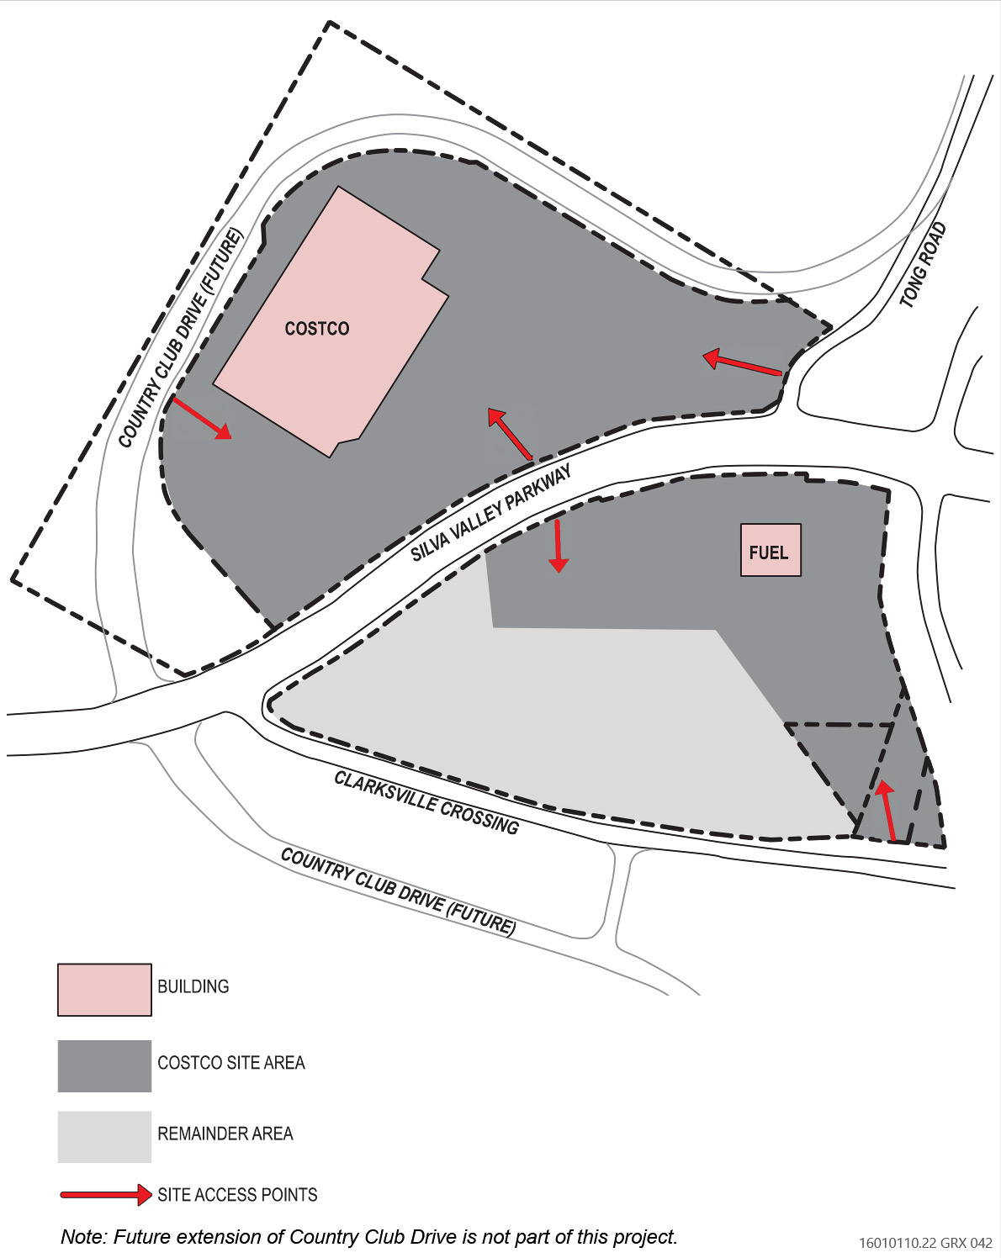
Flipped Costco Project Site Plan Alternative

Slide 19
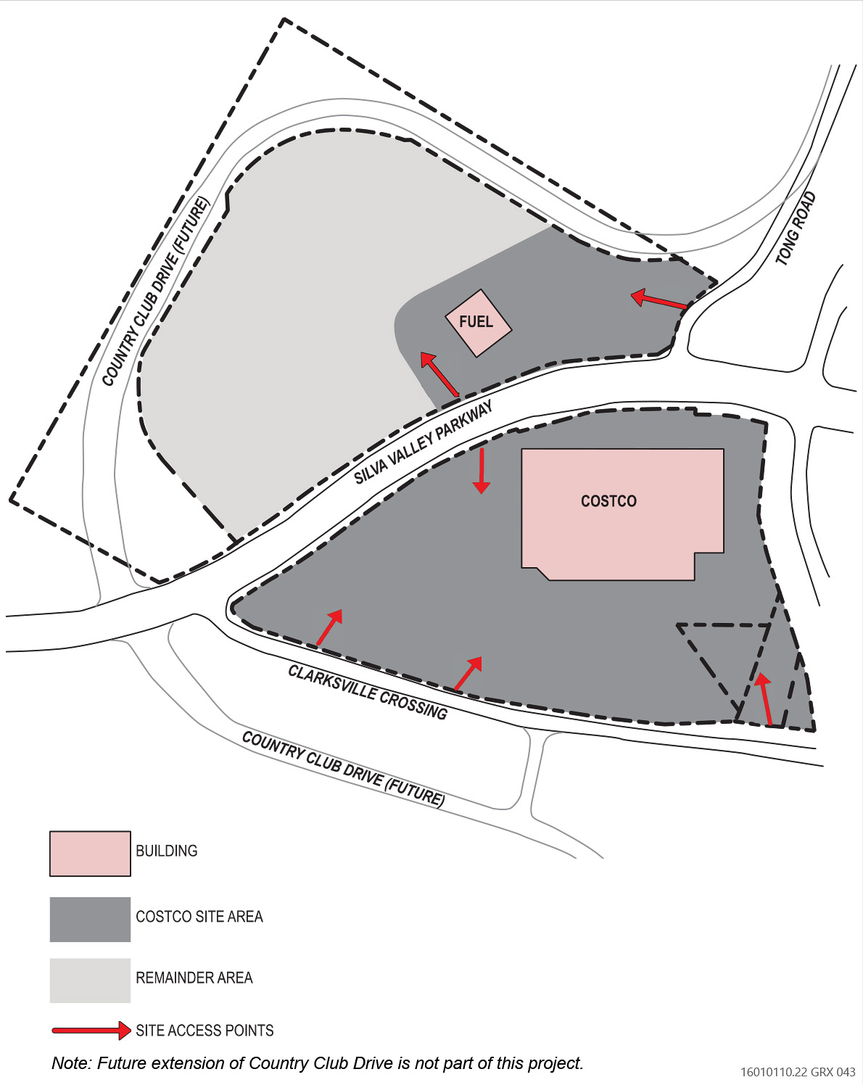
Fuel Facility Relocation Alternative

Slide 20
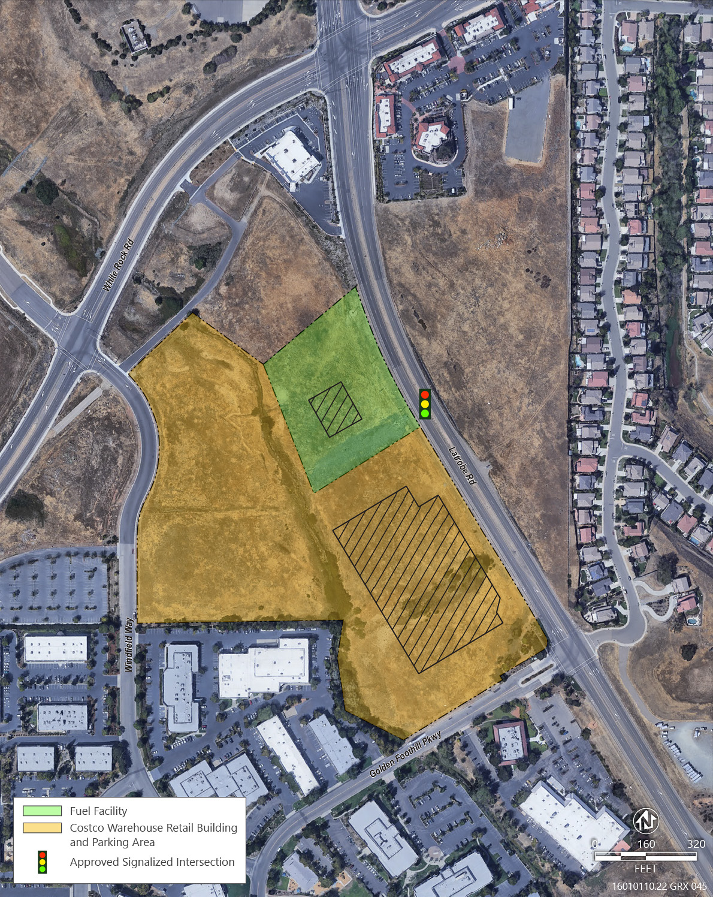
Offsite Alternative

Slide 21
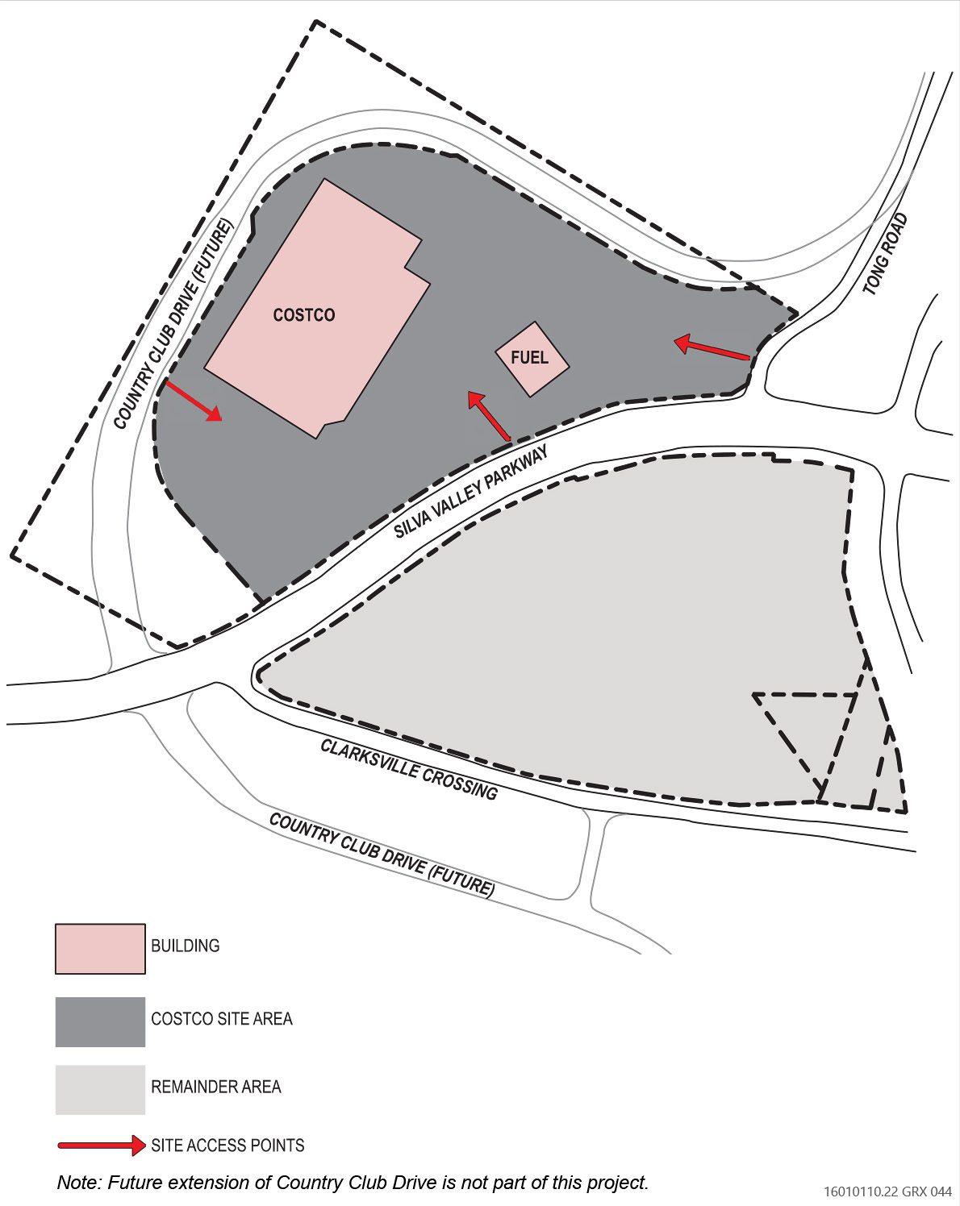
Costco Project on North Site Alternative

Slide 22
Next Steps
Draft EIR
  Draft EIR comment period ends March 23, 2026
Final EIR
  Will respond to all written comments received during Draft EIR review period
Planning Commission Hearing
Board of Supervisors Hearing (if appealed)

Slide 23

How to Submit Written Comments
Email: EDHCostco@edcgov.us
Mail: Cameron Welch, Senior Planner
County of El Dorado Planning Division
2850 Fairlane Court, Building C
Placerville, CA 95667
Comments must be received by 5:00 p.m. on March 23, 2026
Scan for Detailed Instructions:

