Slide 1
Budgeting & contracting workshop
Department of Transportation
October 30, 2024
ZONES OF BENEFIT

Slide 2
agenda
Budget
Review annual calendar of events
Revenue timeframes
Review of prior fiscal year budget
Strategic Planning
Contingencies
Contracting
Maintenance vs. Construction
Contracting Process & Requirements
Timelines
Do’s & Don’ts
Q & A

Slide 3
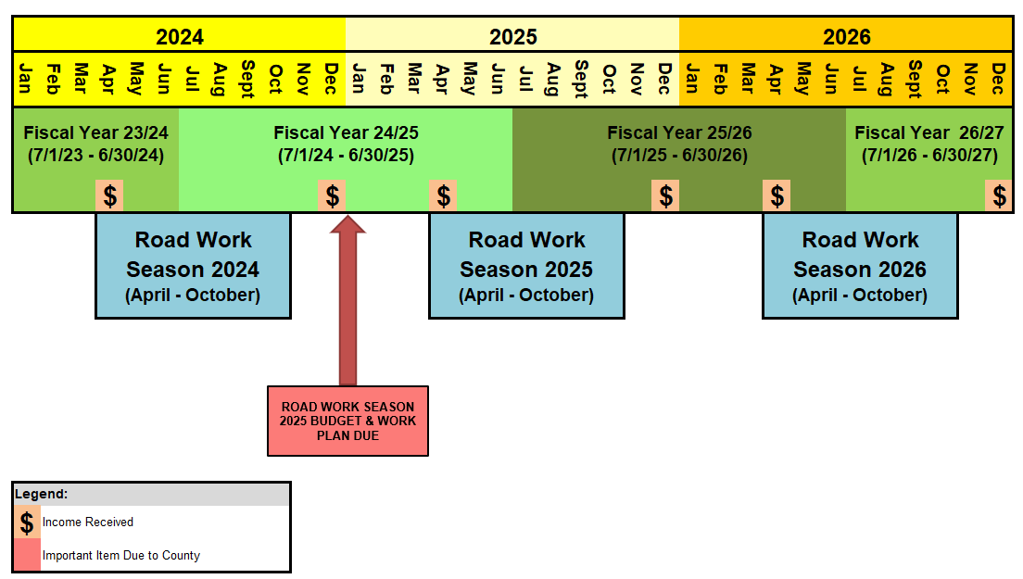
ZONE CALENDAR
Notes:
Work Plans & Budget will be due by January 3, 2025.

Slide 4
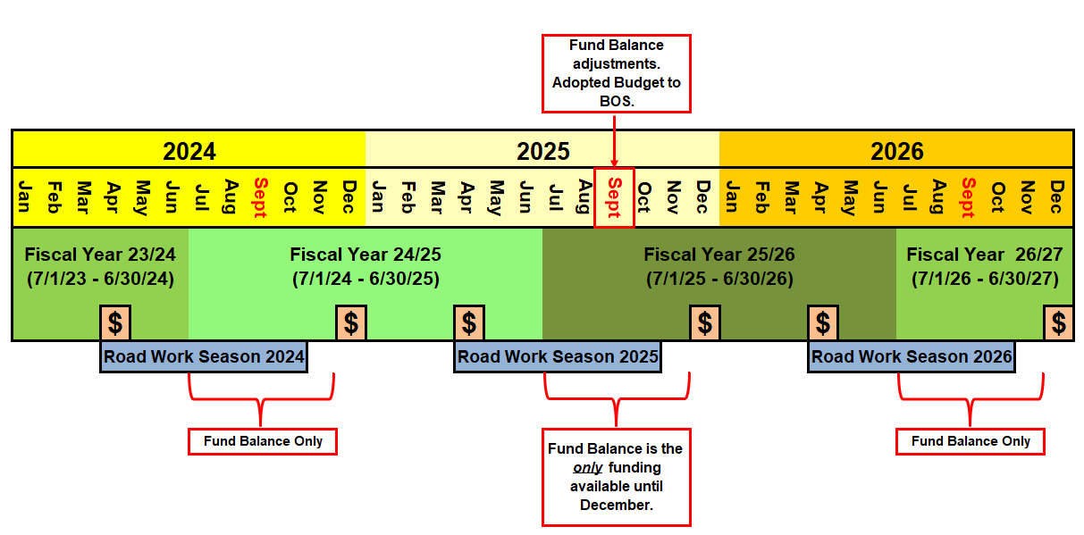
Revenue timeframes
Notes:
Understanding the revenue timeframes is essential. At the start of a fiscal year, the fund balance is the only funding available. Tax installments are received in December and April.
The fund balance adjustments typically take place in September and then the revised budgets are presented to the Board of Supervisors for approval.
Revised budgets for each zone will be emailed to the zone’s key contact following the Board’s approval.

Slide 5
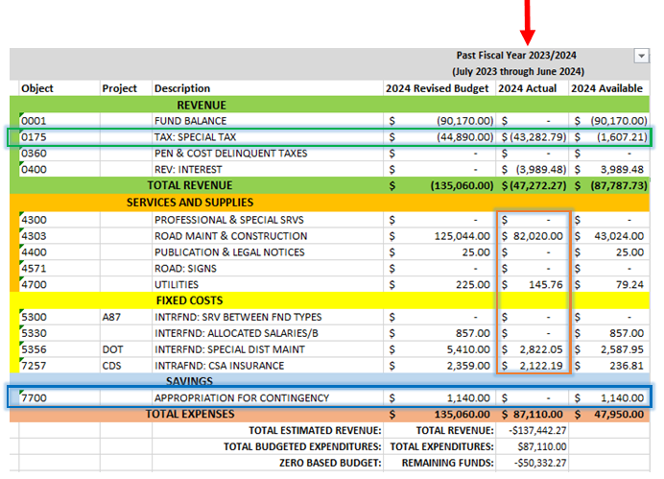
FY 23/24 Budget Review
Notes:
Take time to carefully review the prior fiscal year’s revenues & expenditures.
Conservatively forecast for increased costs or elections that your Zone may be planning for during the current or next fiscal year.
Consider an increase to the Contingency (Savings) for long-term projects and unforeseen expenses that may arise.

Slide 6
Strategic planning FY 25/26 budget & 2025 Road Work Season
Budget & Work Plan Balancing Act
Consider the potential work for the 2025 road work season:
Reflect on Work Plan from prior year’s workbook
As determined during the zone’s Annual General Meeting
Concerning areas following storms
Develop maintenance and construction budgets to support the work desired.
Review and budget any other expenditures.
Office supplies, room rentals, cold patch, etc.
Notes:
The storms experienced in recent years have illustrated the importance of prioritizing projects based on safety.
While regular surface treatments to roadways is a good practice, it is vital that the other infrastructure such as culvert replacements be addressed proactively. Metal culvert pipes rust over time and eventually loose their integrity. If there is undermining of the roadway, the metal culvert pipe will need to be replaced with HDPE culvert pipe.

Slide 7
strategic planning
Review Contingencies/Savings
Set money aside for future (large) projects as documented on the work plan’s long-term planning section
Zones without contingencies are strongly encouraged to establish a “safety net” that is equal to or greater than the budgeted County costs.
Administrative costs can fluctuate from year to year due to a variety of factors including but not limited to:
Contracts and work requests
Legal matters
Public records requests
Correspondence with zone residents/committee
Notes:
Many Zones have opted to reduce or eliminate their Contingencies for several years and this has caused some Zones great heartburn when additional Administrative Costs are incurred as a result of the additional time required to complete budget transfers or other committed time to resolve budget matters that could be avoided had there been savings to use.

Slide 8
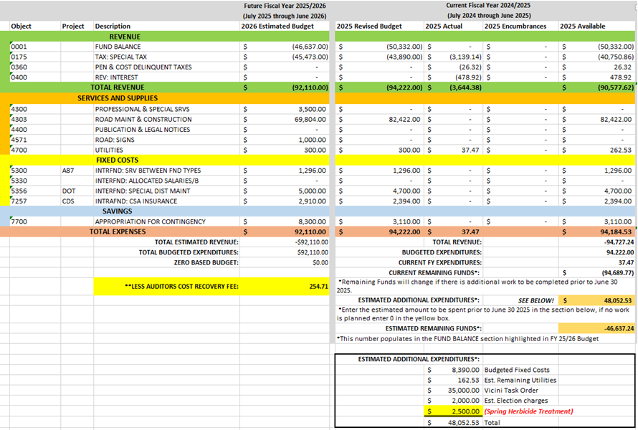
Notes:
The upcoming fiscal year budget is in the left column (see red arrow).
1st step: Review the actual expenses for the Current Fiscal Year (see blue box).
2nd step: Enter any estimated additional expenditures for FY 24/25 (see green box).
3rd step: The Estimated Remaining Funds will calculate automatically. This amount will then auto-populate to the Fund Balance for FY 24/25 (see orange arrow).
4th step: Complete the Future Fiscal Year Budget Category section for FY 25/26 to achieve a Zero-Based Budget (see purple boxes).
Common things to consider and often overlooked:
Utility rate increases
Election costs *This can be up to $2,000 which can be a large expense for smaller zones.
Zones without Contingencies (savings) should be careful planning large projects that could leave minimal funding come Fiscal Year End.

Slide 9
Work plan Road work season 2025
Document desired projects on the Work Plan page of the Budget Workbook.
Be sure to document long-term plans
Consider bringing a copy of the zone’s work plan to each meeting to share with any new residents
Net Balance is what you have available to spend on road work & other expenses
Income less all Fixed Costs = Net Balance
Timing is everything; The earlier the better!
Notes:
What happens if the Work Plan page is not completed, or the quotes exceed what was originally approved?
A noticed public meeting must be conducted to discuss the Work Plan and related amounts.
Meeting Minutes must reflect approval of those in attendance by way of a majority vote.

Slide 10
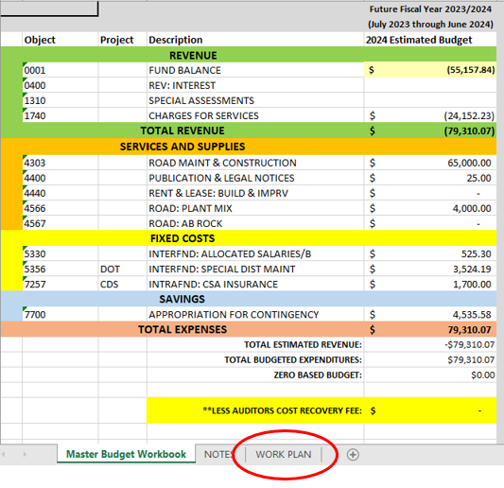
Where is the Work plan?
There are three tabs in your Budget Workbook. To complete the Work Plan, simply select that tab from the bottom of your workbook:

Slide 11
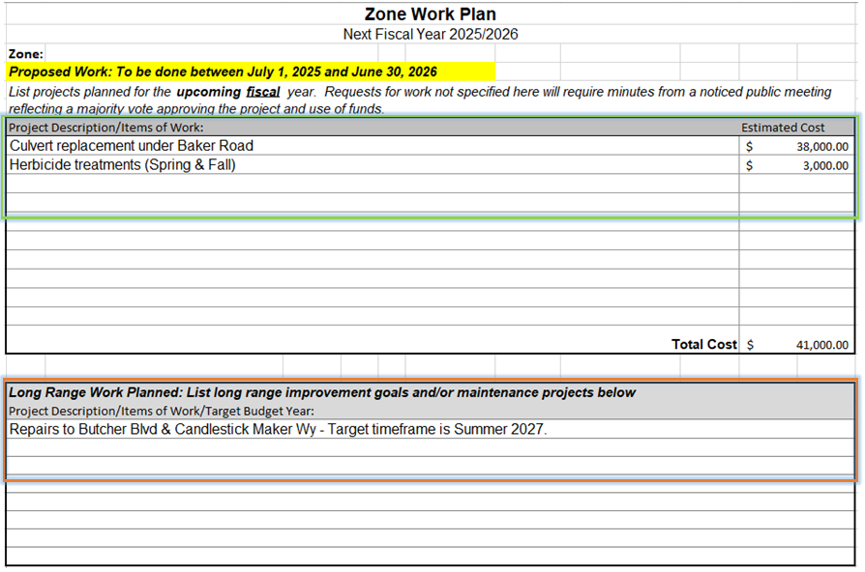
How to complete the work plan
Notes:
Start by entering the work to be completed in the upcoming year and the related estimated amounts (see green box).
Enter work to be completed in future years in the lower portion (see orange box).
What happens if the Work Plan page is not completed, or the quotes exceed what was originally approved?
Requests for work not specified on the Work Plan will require minutes from a noticed public meeting reflecting a majority vote approving the project and use of funds.

Slide 12
Budget deadline
January 3, 2025 – Budget Workbook & Work Plan Due
What happens if a budget workbook is not submitted by the deadline?
DOT will submit the budget on the Zone’s behalf based on previous years’ actuals.
The CAO issues specific deadlines for all budgets.
No changes allowed once submitted to CAO.

Slide 13
Purchasing and Contracting
Goods and Services
Volunteer Work
Contracting

Slide 14
Purchasing & Contracting
Part V, Section F - Policy and Procedure Guidelines:
“The financial management of the zones of benefit shall be treated as any other department of the County.”
Procurement of services and supplies must be in accordance with County policies & procedures and Public Works requirements.

Slide 15
Purchasing
Expenditures must be:
Included in a Board approved line-item budget
Voted on and approved during the General Meeting, or other noticed meeting, as part of the work plan submitted with the budget
Supported by revenues
Made through the proper channels

Slide 16
PURCHASING
Eligible for Reimbursement:
Postage
Office supplies - mailing labels, name tags, envelopes, paper, printer cartridges, staples, writing implements, tape
Printing/copying
Reimbursement Requires:
Certificate of Completion for Ethics Training dated within 2 years
Affidavit for Auditor’s Office
California 590 Form & Payee Data Record
Notes:
The items listed were approved for reimbursement by the Board of Supervisors in 2005. No other items are eligible.
All other purchases for Zone business are made through the County.
CA Form 590 and Payee Data Record are required by the Auditor-Controller’s office to set the committee member up as a vendor with the County with the first reimbursement only.

Slide 17
Purchasing
Contact Transportation in advance for:
Supplies
Road materials
Miscellaneous supplies
Services
Room rentals or use
Materials hauling
Any service provided by an outside vendor or contractor
Any billable services provided by other County Departments
Notes:
Materials like cold mix asphalt and rock can be procured with a Purchase Order for pre-approved Volunteer Work Events.
The County has on-call contracts for some services, including herbicide application for weed abatement and road maintenance services.
Please allow at least 30 days when requesting these purchases. To promote efficiency and reduce administrative time, send us a quote and we will see what we can do for you.

Slide 18
Volunteer Work Program
Projects require County approval.
Submit Request to DOT:
Task(s) to be performed
Materials/Supplies/Equipment, if any
Who will be working
Target date
Supplies must be included in approved budget.
Work must be in roadway easement.
Waivers must be on file before work begins.
Notes:
Please submit the Project Information Form and waivers at least one week prior to the Work Event Date.

Slide 19
Contracting
The County has On-Call Maintenance Contracts:
Herbicide application
Pest Control Center, Inc.
Landscaping maintenance
Ponderosa Landscaping, Inc.
Road maintenance
Macauley Construction
Joe Vicini, Inc.
Doug Veerkamp General Engineering, Inc.
VSS
NOTE: Construction work is not eligible.
Notes:
Using a County approved vendor with an On-Call Maintenance Contract is the most efficient method.
Our office and County Counsel can expedite requests often in less than 5 weeks time when using an On-Call Maintenance Contract Vendor:
Work that is under $25,000 can have a Work Order against the On-Call Maintenance Contract.
Work that is $25,000 or more will have a Task Order against the On-Call Maintenance Contract. *Bonds are required for Task Orders which may add a little time.

Slide 20
Process overview: on-call maintenance contract work
The Advisory Committee will:
Obtain quotes (three is recommended)
Choose contractor
The Key Contact will:
Communicate with the County
Submit/Email the request with all quotes received and the completed Maintenance Location Worksheet.
The County will then:
Review the work plan, quote, and Maintenance Location Worksheet for accuracy
Submit the Work Order/Task Order for Counsel and Director approval
Email the completed Work Order/Task Order to the Contractor and Key Contact as the Notice To Proceed

Slide 21
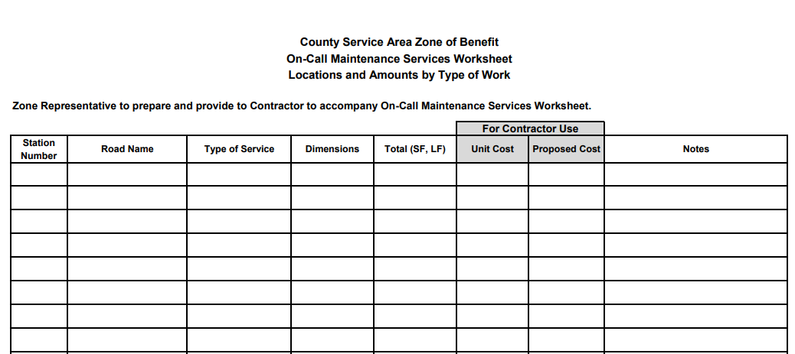
Maintenance location worksheet
This is located on the Zones of Benefit website under Forms & General Information.
Notes:
By submitting this with the request for work and the contractor’s proposal, we can verify that the work will align with the Zone’s intent.

Slide 22
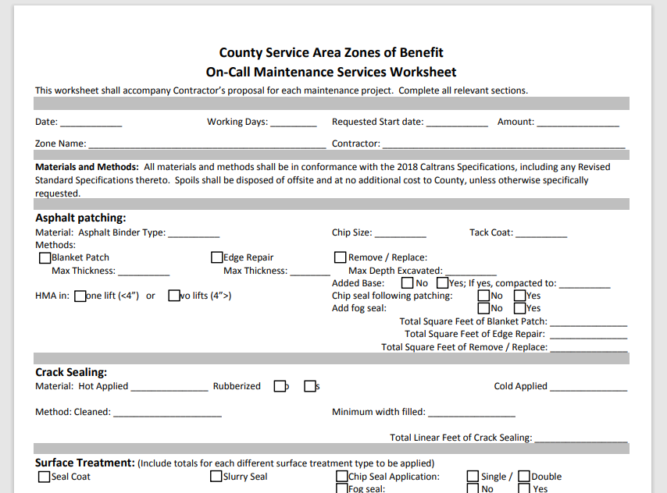
On-call maintenance service worksheet
This is located on the Zones of Benefit website under Forms & General Information.

Slide 23
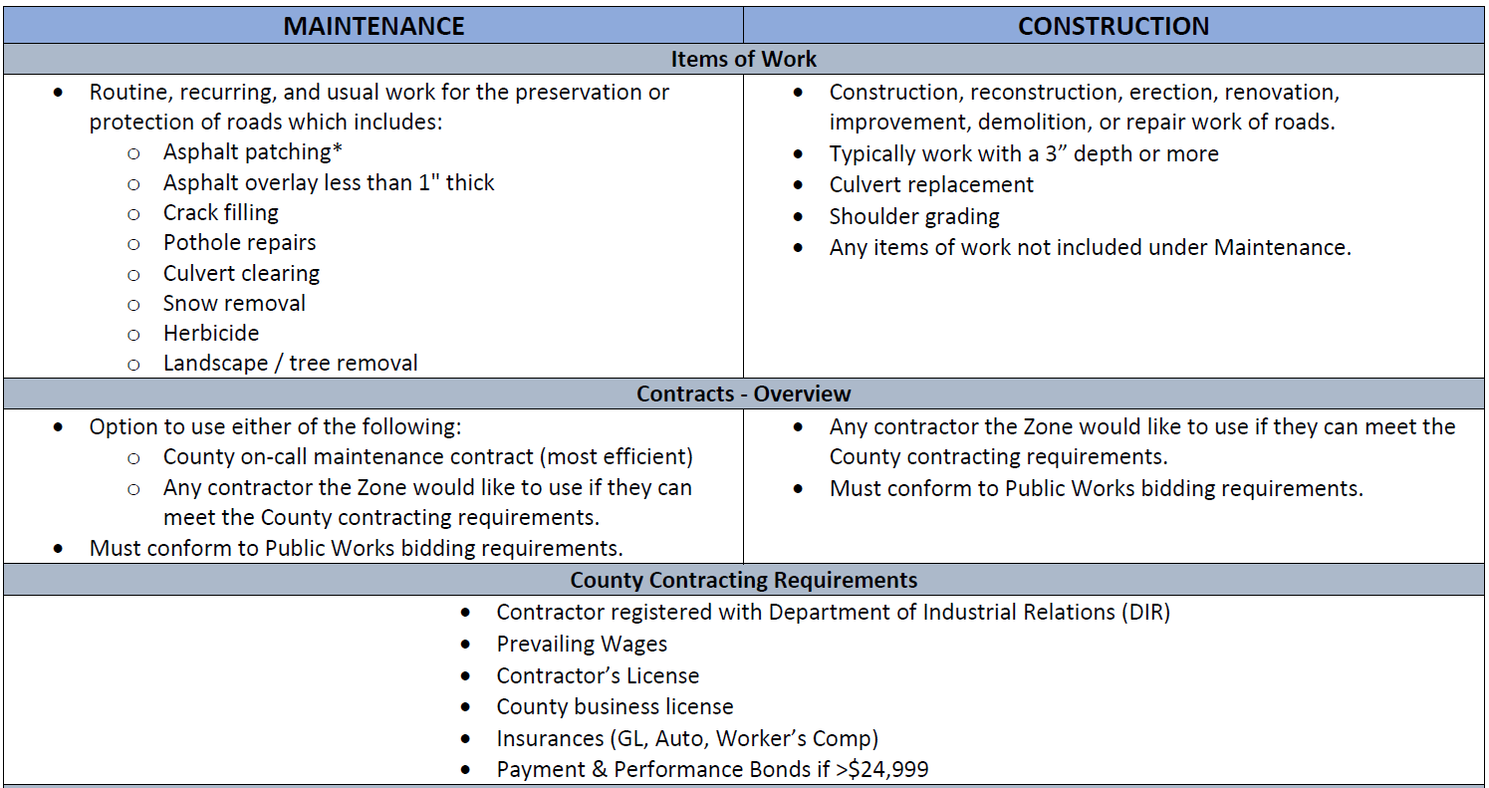
Maintenance vs. construction

Slide 24
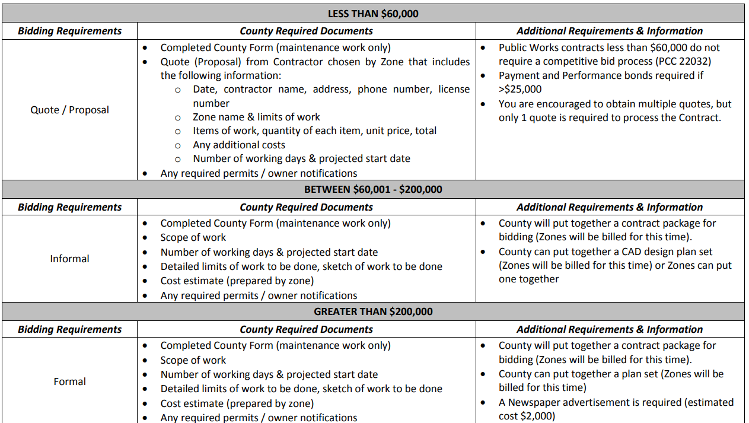
Public Works Contracting

Slide 25
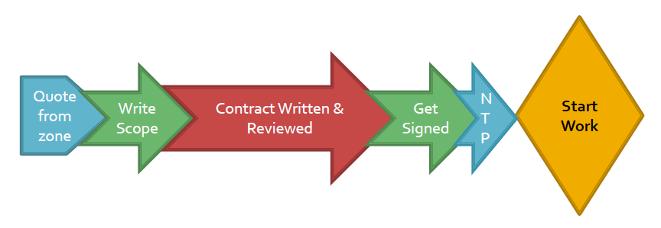
separate contracts
The timeframe to complete a separate contract can be 3 – 6 months.
Processed first in, first out.

Slide 26
Emergency contracts
During declared emergencies, the County can secure an emergency contract for road failures that take place during the declared emergency timeframe.
The cost of the repairs would be charged to the Zone.

Slide 27
Important upcoming Dates
November 5, 2024: Election Day
9 zones have measures on the ballot
December 10, 2024:
The Board will formalize the 2025 committee appointments and the roster will be posted on our website.
January 3, 2025:
FY 25/26 Budget Workbook & Work Plan for 2025 Season Due
July 31, 2025:
Any new committee appointees must submit the Ethics Training Certificate within 6 months.

Slide 28
Resources
Zone of Benefit and my email address:
zoneofbenefit@edcgov.us
elizabeth.hess@edcgov.us
Zone of Benefit Website: https://www.eldoradocounty.ca.gov/Land-Use/Transportation/County-Service-Area-Zones-of-Benefit
Online Local Ethics Training Website:
https://www.fppc.ca.gov/learn/public-officials-and-employees-rules-/ethics-training.html
Notes:
Many common questions can be answered using the various resources available on our website. Please share this with Zone residents!
Hit the SUBSCRIBE button on our website to receive important information as it is updated!

Slide 29
General Q&A

