Slide 1

Zone of Benefit Advisory Committee Orientation
Department of Transportation
OCTOBER 22, 2025

Slide 2
Agenda topics
What is a Zone of Benefit?
Advisory Committee Overview
California’s Open Meeting Laws (The Brown Act)
Ethics Training Requirement
Website Resources
Amended Guidelines, Advisory Committee Manual & Bylaws
Volunteer Work Program
Elections
Zone Calendar
General Questions

Slide 3
What is a Zone of Benefit?
A zone of benefit is:
Part of a County Service Area (CSA)
Governed by the Board of Supervisors
A part of County Government
A guaranteed collection mechanism for funds through property taxes
A zone of benefit is not:
An independent district
An association
Notes:
WHAT IS A ZOB?
A Zone of Benefit is part of a County Service Area where services are funded by either a charge for service/benefit assessment or by a voter approved special tax.
Funds are collected with ad valorem (based on value) property taxes which makes monies “public.”
Districts have elected boards and additional State reporting requirements; They are not under County jurisdiction.
Associations may have no formal collection methods and are not under County jurisdiction or authority.

Slide 4
County Service Areas
County Service Area Law guides program (GOV 25210, et seq)
CSA Laws originated in 1953 to mitigate competing demands for County services between high growth suburban areas and existing rural development.
CSA Laws allow for difference services, or a higher level of services to be available within the CSA that otherwise available in the unincorporated area of a County.
LAFCO forms CSA with defined boundaries
Allowed services must be designated under the CSA
CSA business is administered by the County

Slide 5
County Service Areas Authorized services
Transportation Zones
Other Departments’ Zones
Road Maintenance & Improvement
Drainage Facility Maintenance & Improvements
Snow Removal Equipment and Services
Street Lighting
Landscaping
Wetland Related Services
Cemetery Maintenance & Improvement
Vector Control
Mosquito Abatement
Ambulance Services
Waste Management Services
Library Services
Notes:
COUNTY SERVICE AREAS – AUTHORIZED SERVICES
Transportation oversees services in CSA’s 2, 3, 5 & 9.

Slide 6
















County Service Areas services overview
CSA 2
CSA 3
CSA 5
CSA 9
CSA 10
CSA 7
Notes:
CSA– SERVICES OVERVIEW
The zone purpose is designated at formation from among services specified for the CSA.
A CSA may be stand-alone with no zones, like CSAs 5 & 7.
Alternatively, a CSA may serve as the entity or district to facilitate specific services such as with CSA 3 providing mosquito abatement, ambulance services and snow removal services.
Zones may encompass smaller areas within the CSA, like the many different purpose Zones of Benefit in CSA 9.

Slide 7
County Service Areas summary by service
CSA No. | Year Formed | Types of Services | Area | No. of Zones
2 | 1963 | Road & Drainage Maintenance & Improvements | Near "Four Corners," west of Lotus Rd at Luneman Rd | 2
3 | 1963 | Vector Control, Ambulance Services, Drainage, Snow Removal Equipment & Services | Entire Tahoe Basin of El Dorado County | 6
5 | 1970 | Drainage & Erosion Control | Tahoe-Cedars Subdivison at northern boundary of El Dorado County in the Tahoe Basin | 1
7 | 1976 | Ambulance Services | Entire West Slope of the County | 1
9 | 1983 | Roads, Drainage, Cemetery, Landscape, Street Lighting, Wetland Related Services | Entire West Slope of the County | 95
10 | 1988 | Waste Management & Library | Encompasses the whole of El Dorado County | 10
Notes:
CSA– SUMMARY BY SERVICE
Administration of the CSAs originated in the Chief Administrative Office. Later, Administration was shifted to different County departments based on the services.

Slide 8
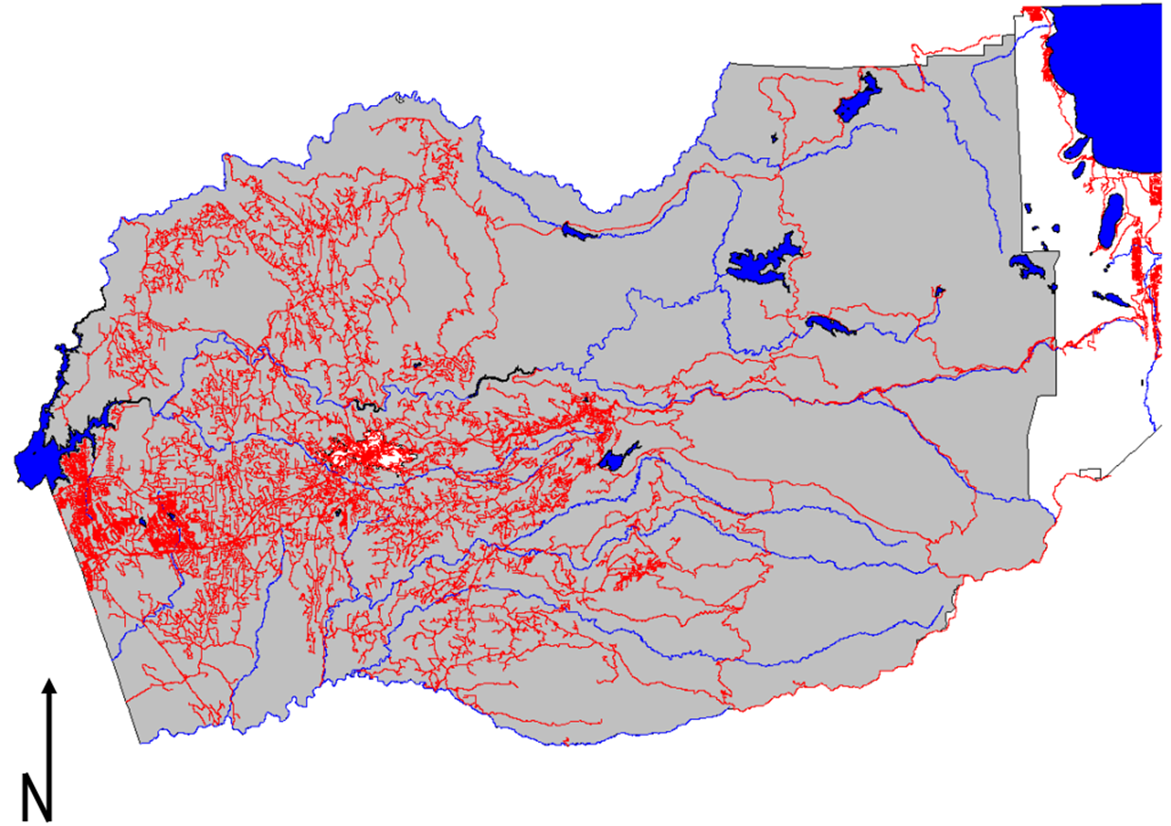
CSA 9
Notes:
CSA 9
Encompasses the Western Slope of El Dorado County. The vast majority of our Zones of Benefit are within CSA 9.

Slide 9
Road Zones of Benefit
Road Maintenance Zones
2 in CSA 2 (circa 1979)
39 in CSA 9 (circa 1980’s - early 2000’s)
Roads are not County Maintained.
Public roads, privately maintained.

Slide 10

Zone advisory committees
Overview
Responsibilities
Meetings & the Brown Act
Ethics Training

Slide 11
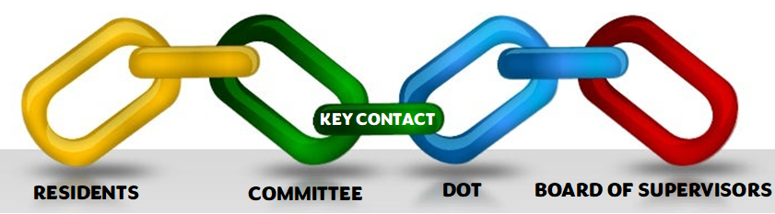
Advisory Committee overview
The Advisory Committee is the link between DOT and the residents.
DOT is the link between Committees and the Board.
Notes:
ADV COMM - OVERVIEW
The Key Contact is a designated Advisory Committee Member who serves as a liaison for discussing budget matters and coordinating work to be completed with County staff.
Advisory Committee Members shall provide all residents in their zone with an equitable level of concern and attention.
Residents within a zone are encouraged to participate in all zone meetings and to work closely with their Advisory Committee.

Slide 12
Advisory Committee overview
Board of Supervisors establishes a committee at its discretion.
The Resolution forming a zone will include specific findings when a committee is designated.
Committee Members serve at the pleasure of the Board.
Input from an advisory committee and its members are wholly advisory.
It is not within the authority of an advisory committee or its members to make decisions, manage or direct the delivery of services on behalf of the zone.
Department of Transportation facilitates communication.
Many levels, many subjects
Various departments
Numerous resources readily available on our website

Slide 13
Advisory Committee & DOT Responsibilities
Advisory Committee Responsibilities
Meet with property owners and residents to:
Evaluate adequacy of services
Recommend annual budget and work plan
Recommend action to the County
Subject to California’s open meeting laws (The Brown Act).
Adhere to program guidelines & bylaws.
Ethics Training for Local Officials required for reimbursements.
DOT Responsibilities
Works with Advisory Committees to:
Evaluate adequacy of services
Develop annual budget and work plan
Recommend action to the County CAO, Board
Ensure Zones comply with requirements of the program.
We are here to help you navigate processes and support the zone’s operations.
Notes:
ADV COMM & DOT RESPONSIBILITIES
Described further in the Policy & Procedure Guidelines & Advisory Committee Manual.
On September 10, 2024, the Board of Supervisors approved the amended Program Guidelines and Advisory Committee Manual which includes bylaws.
All committee members should familiarize themselves with these documents.

Slide 14
Advisory committee meeting requirements
All meetings are subject to provisions of the Brown Act - California’s Open Meeting Laws
Four meetings per year
One of the four is the General Meeting
Advance agenda to County for approval one week before the meeting date
Provide minutes to the County within one week, even if not yet adopted
Follow procedures detailed in the bylaws
Notes:
ADV COMM MTG REQUIREMENTS
Consider keeping a copy of the bylaws on-hand during publicly noticed meetings should any procedural questions arise. Contact the County with any specific questions.

Slide 15
Brown Act
What is the Brown Act?
The Ralph M. Brown Act, California’s Open Meeting Law:
“Open decisions, openly arrived.”
Guarantees the public’s right to attend the meetings of public agencies
Facilitates public participation in all phases of local government decision-making
Curbs misuse of the democratic process by secret legislation
Notes:
BROWN ACT
Zones of benefit activities are funded with special taxes or benefit assessments collected through the County’s tax roll.
These funds are public monies, and decision making (even recommendations) for the use of public monies is business of the public, and therefore subject to the Brown Act.

Slide 16
Brown Act Requirements: Meetings
What is considered a meeting?
Any congregation of a majority of the members of a legislative body at the same time and location … to hear, discuss, deliberate, or take action on any item that is within the subject matter jurisdiction of the legislative body.
The legislative body does not need to take action in order for it to be considered a meeting.
Notes:
BROWN ACT REQUIREMENTS - MTGS
Even though the committee may be discussing a limited scope of business in a limited area, the business is still public business.

Slide 17
Brown Act Requirements: rules for meetings
Must be open and public
Facilities must allow ADA accommodation for participation
Committees cannot require a member of the public to register his or her name or provide other information as a condition to attendance (an attendance list must indicate that signing is voluntary)
The public has a right to record and broadcast the meeting
The Agenda must be posted 72 hours in advance
Each meeting shall have a separate public comment item
Notes:
BROWN ACT REQ – RULES FOR MTGS
All zone of benefit advisory committee meetings are open to the public at large, meaning anyone who may be interested in a zone’s business – even if they do not own property in the zone or live in the zone.

Slide 18
Brown Act Requirements: rules for meetings
Items not on the Agenda:
No discussion or decision on items not on the posted Agenda
Committee members may respond briefly to questions posed by the public
Committee members may make a brief report on his/her own activities
Committee members may request the inclusion of an item at a later meeting or place a matter on a future agenda

Slide 19
Public comment
Every meeting agenda must allow the public to speak on any item of interest within the subject area of the legislative body.
Public must be allowed to speak on specific item of business before or during the consideration of the item.
Committees may adopt reasonable regulations for public comment (e.g. time limits)
Committee Members may not prohibit criticism of policies, procedures, programs or services, or of the acts or omissions of the legislative body
Notes:
PUBLIC COMMENT
It is permissible, and strongly recommended, to include a time limit for each person registering public comment.
If action is considered on an issue brought up in public forum, put it on the next meeting agenda.

Slide 20
Beware of Serial meetings
A majority of members of a legislative body shall not, outside of an open and public meeting, use a series of communications of any kind, directly or through intermediaries, to discuss, deliberate, or take action on any item of business within the subject matter jurisdiction of the legislative body.
Commonly referred to as a serial meeting:
Daisy Chain (Member A to Member B and Member B to Member C)
Hub and Spoke (Member A to Member B and Member A to Member C)
This can occur through email or text message communications – do not use reply all.
Notes:
SERIAL MEETINGS
Incidental exchanges of emails or texts, even if through an intermediary or third party can become “accidental” serial meetings. Best practice – do not discuss zone business among committee participants via email or texts.
However, it is permissible for each member of a committee to send an individual message to a point of contact for consensus of a meeting time and date.
Use caution when sending emails and send the email to yourself with a blind-copy to the other members. This ensures no one can reply all on the thread.
Contact zoneofbenefit@edcgov.us if you have additional questions about serial meetings.

Slide 21
Brown Act Requirements: Documentation
Agenda – a public record
Use the Sample Agenda & Notice provided by County Counsel
Brief description (20 words) of topics
Allow time for Public Comment on all action items
Include ADA statement
Must be posted in conspicuous places around the zone and at the meeting location 72 hours before the start of the meeting
Submit to DOT a week prior to meeting date for approval
Minutes – also public record
Utilize the Agenda
Objectively document any action taken
Provide to the County, even if not adopted within one week
Even if your internet is down, we must receive the minutes. Consider mailing or delivering.
Notes:
BROWN ACT REQ – DOCUMENTATION
Both Agendas and Minutes, and any attachments to them, are public records and must be promptly made available to the public.
The County is the custodian of records for the zones on behalf of the Board.

Slide 22
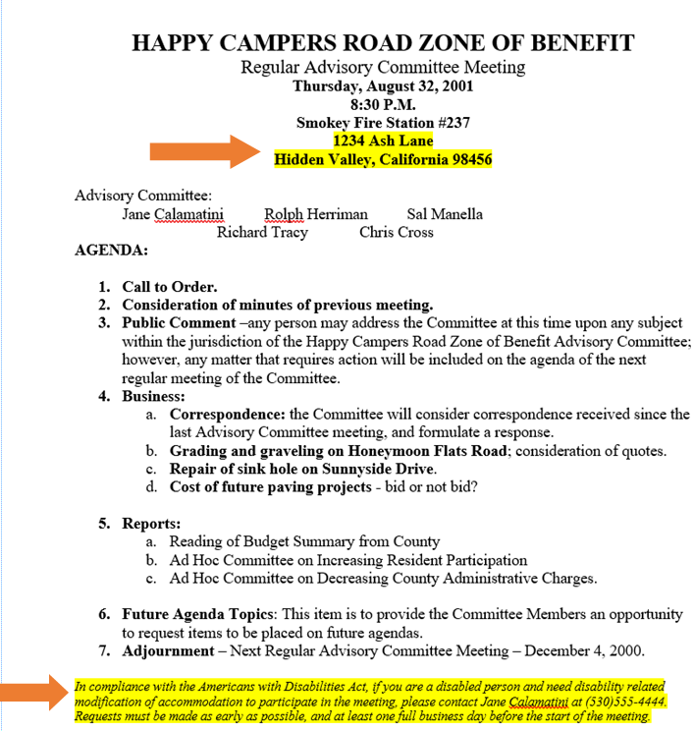
Notes:
Example Agenda – Use the template and keep it simple.
A location address must be provided.
The ADA statement must be included exactly as worded.
Public Comment must be allowed for every action item.
*Note: Additions to Agenda removed. Unless a true emergency arises, items may not be added to an already posted Agenda.

Slide 23
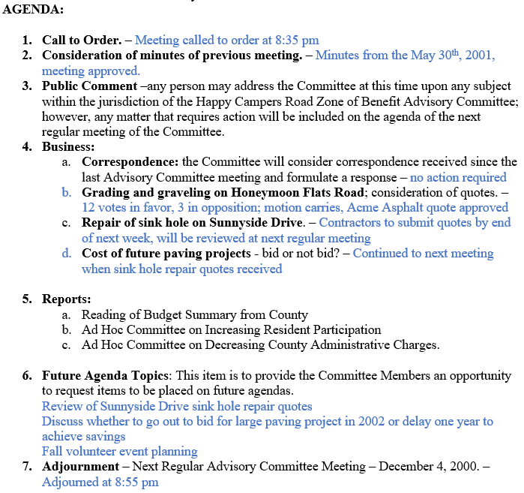
Notes:
Example Minutes - Objectively note actions taken or decisions made on the approved agenda.
Minutes should not include long paragraphs; Be concise and clear.
Minutes should not be used as a forum for registering opinions or complaints.
A draft version of the minutes should be provided to the County within a week of each meeting, followed by the final version approved at a subsequent meeting.
Remember, these become public record and any member of the public has a right to review such documents, including the zone’s budget.

Slide 24
Brown Act Requirements: Noticing
Set regular dates, time and place
Post Agendas at least 72 hours in advance:
Posting locations must be freely available to the public, such as common areas or entrances/exits to the zone.
Agenda must also be posted at the meeting location.
Publish schedule annually
Zone Website or social media page
Neighborhood Bulletin Board
Mail advance notice of each meeting
When written request is on file for that calendar year.
Include the Agenda and any other documents to be distributed.
Emailing to the requestor is okay.
Emailing the Agenda and Notice exclusively, and/or telephoning residents and property owners about a meeting does not meet the noticing requirements of The Brown Act.
Notes:
BROWN ACT REQ - NOTICING
Postings should be in the same conspicuous location(s) each time.
These are the minimum requirements. It may be your zone’s practice to mail notices to everyone two weeks or so before a general meeting.

Slide 25
Brown Act: Consequences
Any person or entity can file an action in Superior Court
Violations could invalidate actions taken
Applies to non-compliance with open meeting laws
Noticing requirements
Agenda requirements
Serial meetings
Criminal misdemeanor
All committee members involved based on:
Participation in the meeting
Knowledge that the law is being violated
Local District Attorney files charges
Zone funds cannot be spent on defense

Slide 26
Don’t
Discuss zone business via telephone, text, social media posts or email.
Discuss zone business without a properly noticed meeting which includes an agenda.
Take action on an item not already included on the published meeting agenda.
Allow personal feelings or bias to impact how zone business is conducted or how work is selected.
Notes:
DON’T…
Public Servants must maintain a high standard of ethical conduct to promotes public confidence that public officials’ actions are motivated solely by the public’s interests.

Slide 27
Do
Be transparent and conduct business as a public servant.
Get a consensus for a meeting date and time.
Add issues to the next meeting agenda – and set the date and time.
Avoid opportunities for accidental serial meetings.
Notes:
DO…
It is permissible for each member of a committee to send an individual message to a point of contact for consensus of a meeting time and date.
Use caution when sending emails and send the email to yourself with a blind-copy to the other members. This ensures no one can reply all on the thread.

Slide 28


Community engagement
Consider establishing a welcoming committee to greet new residents that move into your area. Offer to introduce them at an upcoming advisory committee meeting and encourage them to get involved when they feel ready.
Success Story: One zone has perfected the art of welcoming new residents and maintaining active community involvement through regular communication and hosting an annual potluck BBQ to promote a sense of community and fellowship.
Notes:
COMMUNITY ENGAGEMENT
Building trust with the community and encouraging folks to get involved is a key factor toward having a successful and effective zone of benefit.

Slide 29
Ethics Training
Zone Advisory Committee Members are Local Officials
Includes Conflict of Interest, “perks” rules, and Brown Act
Certificate of completion is required for reimbursement of eligible expenses:
Two (2) hours of training required
Certification lasts for two (2) years
Certificates are retained by the County as part of the zone’s public record
Must be provided to the County
Notes:
ETHICS TRAINING
The Ralph M. Brown Act is part of the curriculum; however, additional topics apply.
For example, did you know it is not appropriate for more than one person per household to serve on the same committee? To avoid accidental meetings, and weighting representation of the property owners and residents, only one member per household should be on the committee.

Slide 30
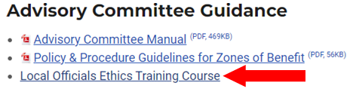
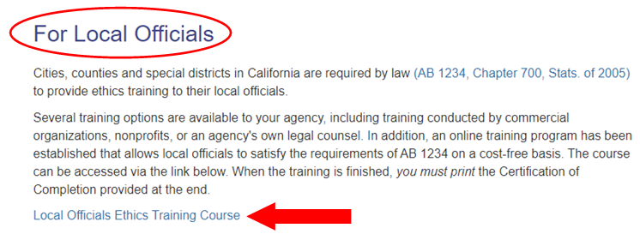
Ethics Training
How do we find the online training?
The link is on our website!
Select the Local Officials Ethics Training Course:
Notes:
ETHICS TRAINING
If you have questions, concerns or technical issues related to the online training program, please email ab1234@fppc.ca.gov, as seen at the bottom of their website.

Slide 31
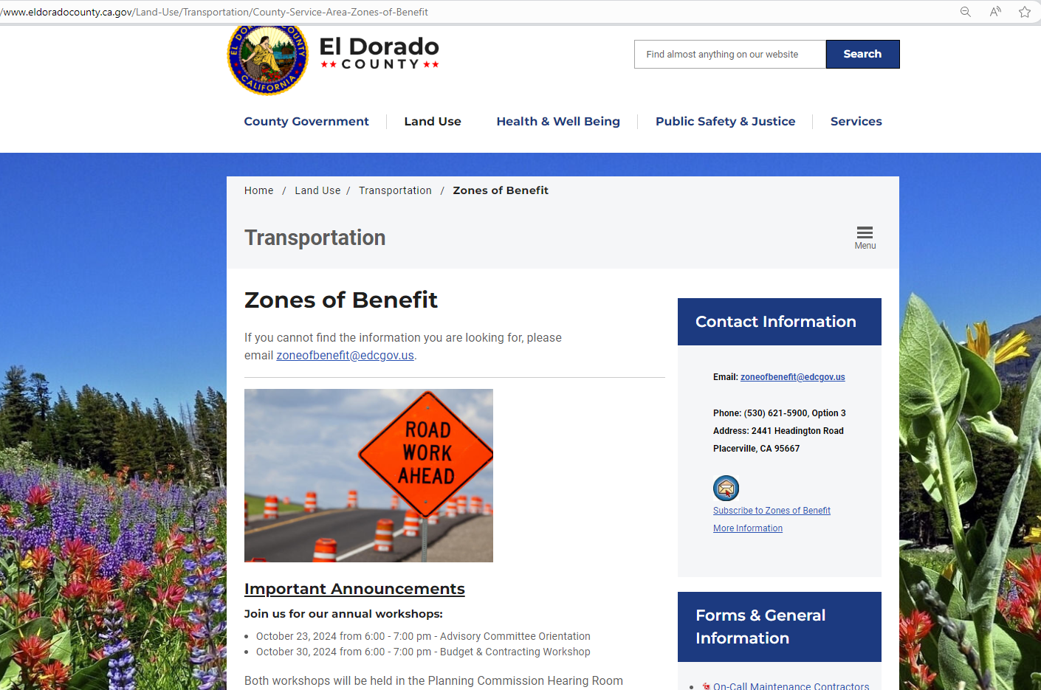
Our website
Notes:
ZOB WEBSITE
Numerous resources are readily available on the Zones of Benefit Website to assist Committee Members.
Easy to find! Google, “El Dorado County Zones of Benefit” and you will be directed to our page.

Slide 32
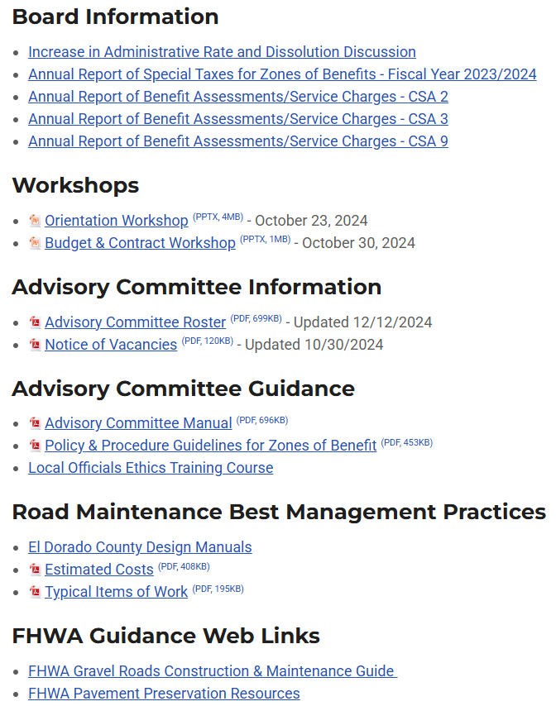
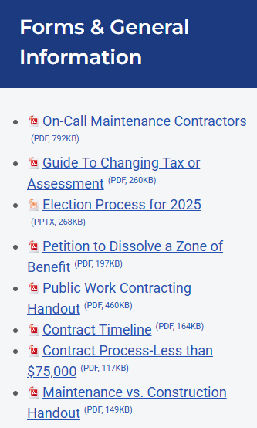
Resources on our website
Notes:
RESOURCES ON WEBSITE
Looking to reduce administrative costs? Take advantage of the extensive resources available on our website!
Many questions can be answered by exploring the Advisory Committee Guidance and Forms & General Information sections.

Slide 33
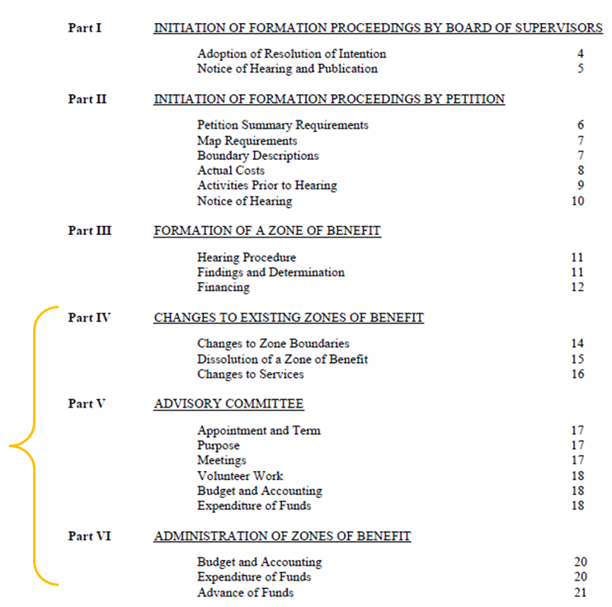
Program guidelines
The Guidelines address a wide range of topics, offering guidance on processes for modifying zone boundaries, adjusting services, and dissolution.
Advisory Committees should familiarize themselves with Parts V and VI, in addition to the Advisory Committee Manual which now includes bylaws.
Notes:
GUIDELINES
The Guidelines are always available on our website under the Advisory Committee Guidance section.

Slide 34
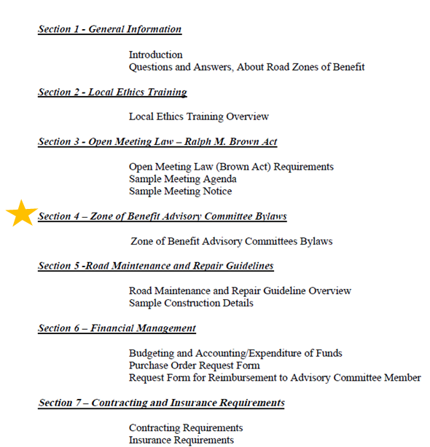
Advisory Committee Manual
Many topics are covered in the Advisory Committee Manual and all committee members should take time to review this vital resource.
The most important update is the inclusion of bylaws in Section 4.
Notes:
ADV COMM MANUAL
One can always find the Advisory Committee Manual under the Advisory Committee Guidance section on our website.

Slide 35
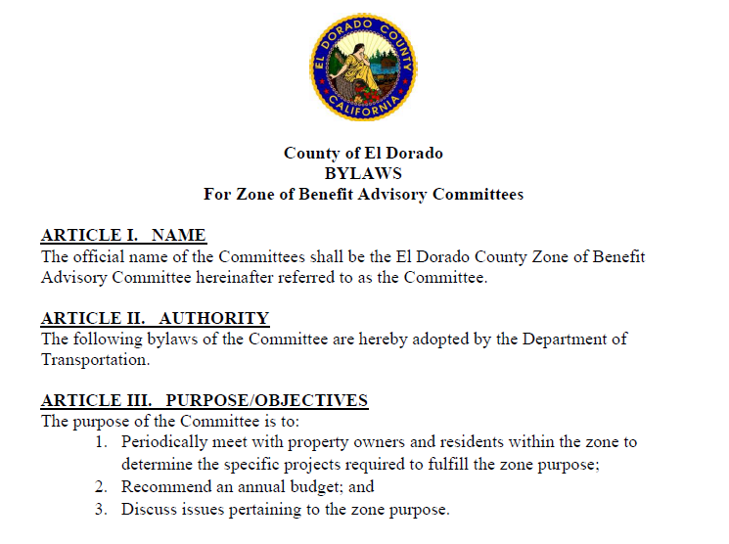
Advisory Committee Manual: bylaws
Notes:
BYLAWS
Section 4 of the Advisory Committee Manual includes the bylaws.

Slide 36
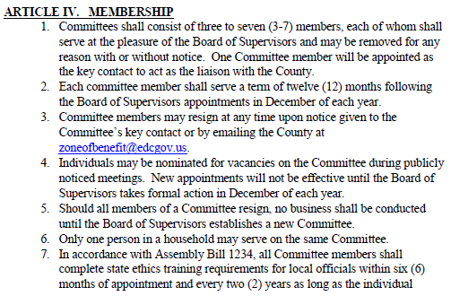


Bylaws: Membership

Slide 37
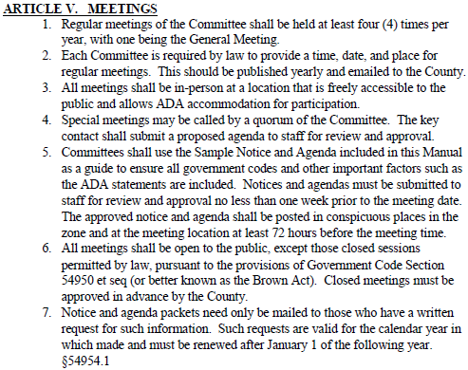
Bylaws: meetings

Slide 38
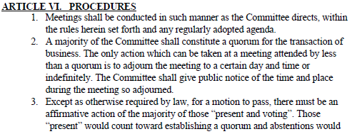
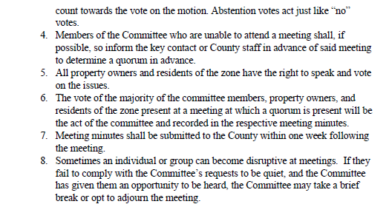
Bylaws: procedures

Slide 39
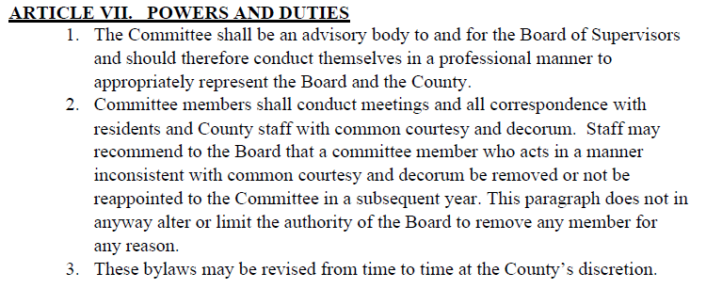
Bylaws: powers and duties

Slide 40
Volunteer Work Program
The Volunteer work program was approved by the Board of Supervisors in 1992 on a trial basis. In 1996, it was given permanent status.
It was always intended to be a supplement to the work program, not a replacement to contracting.
Volunteer work is limited to the following tasks which represent relatively low risk to the zone residents and the County:
Brush/Tree/Weed Trimming
Pothole Patching
Clearing ditches
Trash pickup
Minor snow removal
Notes:
VOLUNTEER WORK PROGRAM
Associated expenditures are covered in Section 5 of the Advisory Committee Manual, Financial Management.

Slide 41
Volunteer Work Program
Projects require County approval
Submit Request to DOT:
Task(s) to be performed
Materials/Supplies/Equipment, if any
Who will be working
Target date
Supplies must be included in approved budget.
Work must be in roadway easement.
Waivers must be on file before work begins.
Waivers and Project Information Sheet are on our website.
Each volunteer event requires a separate Project Information Form and individual waivers.

Slide 42
Elections
Zones must generate enough revenue to support the authorized services, program costs, and insurance. Given the ever-increasing prices for road work, zones need to ensure their annual rates are sufficient.
If your zone’s current annual rate is not tied to an official inflation index, it may be time to request an election.
Visit the Zones of Benefit website for the following:
Guide to Changing Tax or Assessment
Helpful methods to determine an appropriate amount
Important factors for consideration such as an inflation factor
Election Process (PowerPoint)
Key deadlines and example timeframes included

Slide 43
Elections: chain of events
Advisory Committee conducts a publicly noticed meeting and the Agenda must specifically address the topic.
For example, “Propose $100 increase to special tax amount.”
Minutes of the Meeting are provided to our office containing the recommended special tax amount and desired election timeframe.
Key Contact submits email request and the Minutes.
No less than 125 days prior to the Election, the Board of Supervisors must approve the Resolution Setting the Election.
Ballots are mailed approximately one month prior to the Election Day.
Special Tax is placed on the Tax Roll for the upcoming year, if approved.
Notes:
ELECTIONS – CHAIN OF EVENTS
When our office receives an email from the Key Contact with the recommendation and the related Meeting Minutes, we will prepare the following:
Schedule with Elections and Board of Supervisors
Resolution with Ballot Question for County Counsel’s review
Board of Supervisors Agenda Item

Slide 44
Elections: Deadlines November 3, 2026 General Election
April 1, 2026 – Deadline to submit Meeting Minutes & recommendation to DOT for June 2026 Board date
June 2026 – Resolution to Board setting measure for election
October 2026 – Ballots Mailed
November 3, 2026 – Election Day
Notes:
ELECTIONS - DEADLINES
There are firm deadlines to meet a specific Board date and subsequent Election date.
As the updated Elections Calendar is made available, our website’s Election Process resource will be updated with the 2026 deadlines.

Slide 45
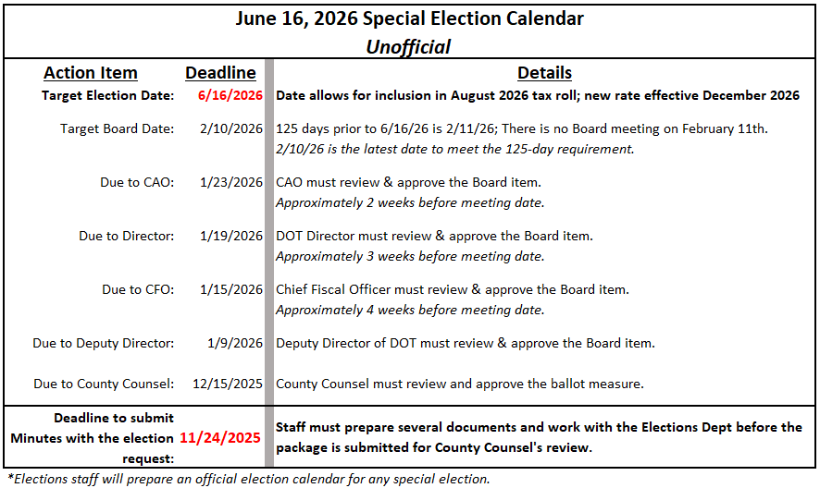
Elections: special election example timeframe
Notes:
SPECIAL ELECTIONS
While Special Elections are more costly, they offer an alternative to the scheduled elections.
Staff is unable to provide an estimate for the costs as the Elections Department will bill based on time and materials.

Slide 46
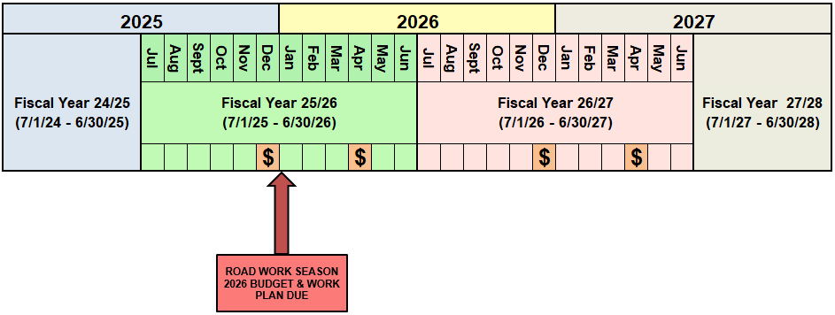
ZONE CALENDAR
Notes:
ZONE CALENDAR
Work Plans & Budget will be due no later than January 3rd, 2025.

Slide 47
Important Upcoming Dates
October 29, 2025 – Budget & Contracting Workshop
January 5, 2026 – Deadline to submit 26/27 Budget & Work Plan
Notes:
Remember:
If DOT does not receive the Budget Workbook by the deadline, staff will submit a budget to the Auditor’s Office on the Zone’s behalf based on the previous year’s actuals.

Slide 48

Resources
Zone of Benefit email address & My email address:
zoneofbenefit@edcgov.us
elizabeth.hess@edcgov.us
Zone of Benefit Website:
https://www.eldoradocounty.ca.gov/Land-Use/Transportation/County-Service-Area-Zones-of-Benefit
Notes:
RESOURCES
Please be sure to hit the SUBSCRIBE button on our website to receive important information as it is updated!

Slide 49
General Q&A

